Slide 1

The Los Alamos National Laboratory nEDM Experiment
Felicity B. Hills
University of Michigan, Ann Arbor
nEDM 2023

Slide 2
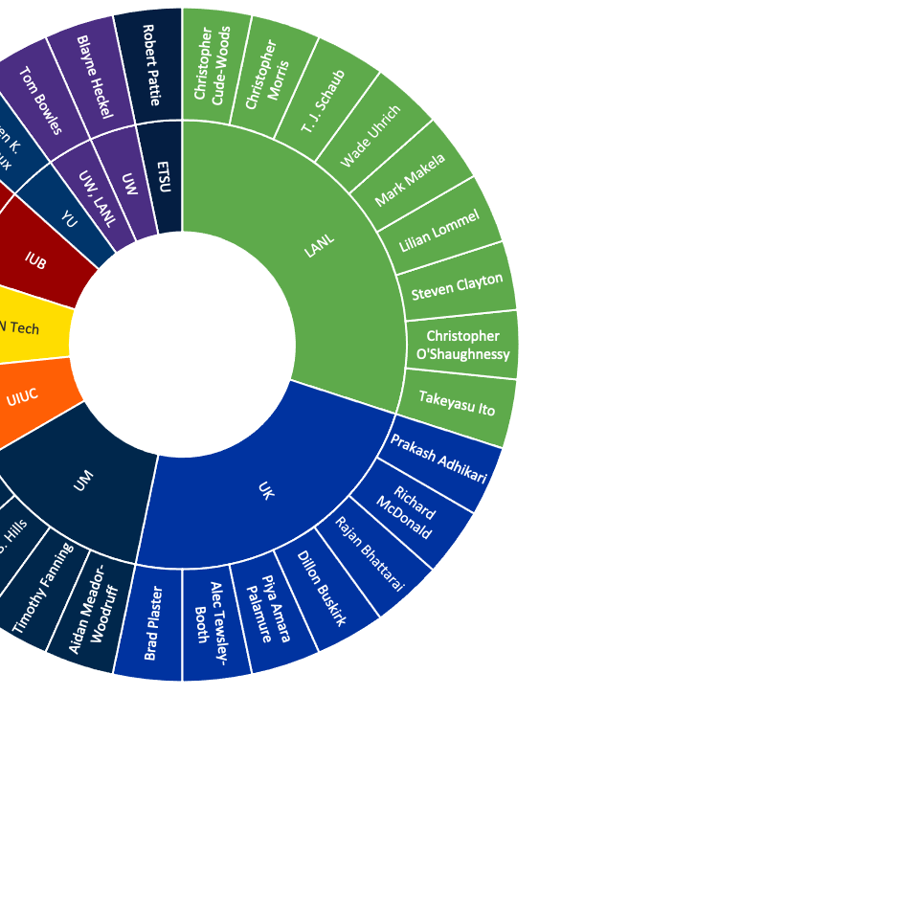
The LANL nEDM Collaboration
This work is funded by LANL LDRD, NSF, and DOE

Slide 3
Upcoming LANL nEDM Talks
Title | Speaker | Day | Time
Magnetic Mapping Amelioration | Austin Reid | Tuesday | 4:50 PM
199Hg magnetometer for LANL nEDM experiment | Jennie Chen | Tuesday | 5:10 PM
Characterization of the magnetically Shielded room for the LANL nEDM experiment | Felicity Hills | Wednesday | 2:00 PM
B0 magnet for the LANL nEDM experiment | Dillon Buskirk | Wednesday | 2:20 PM

Slide 4
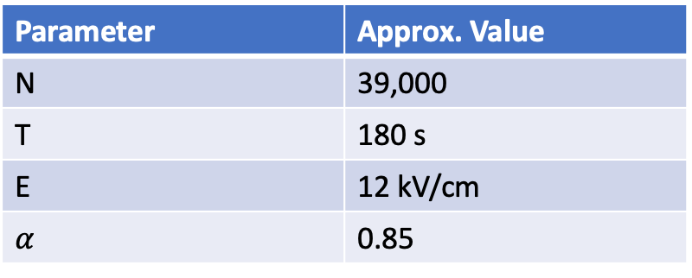
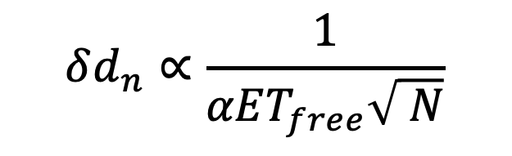
How do we reach ~2x10⁻²⁷ e-cm in a Ramsey Separated Oscillatory Field nEDM Experiment? → Statistical Sensitivity and Magnetics
For 365 days of data collection, we need:
$$δd_{n}∝\frac{1}{αET_{free}\sqrt{ N}}$$
Parameter | Approx. Value
N | 39,000
T | 180 s
E | 12 kV/cm
$$α$$ | 0.85
How are we doing it?

Slide 5
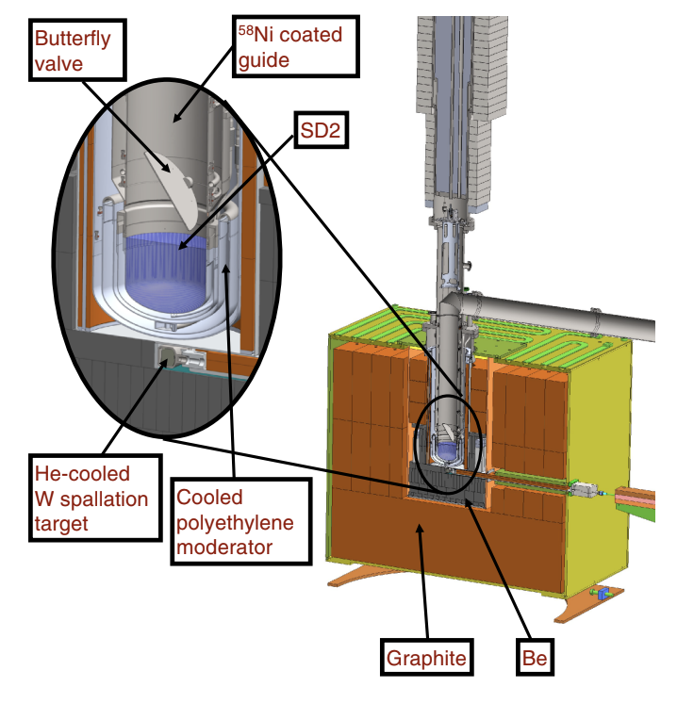

N ~ 39,000 UCN
Spallation neutrons with an SD2 converter
Tour Thursday!

Slide 6
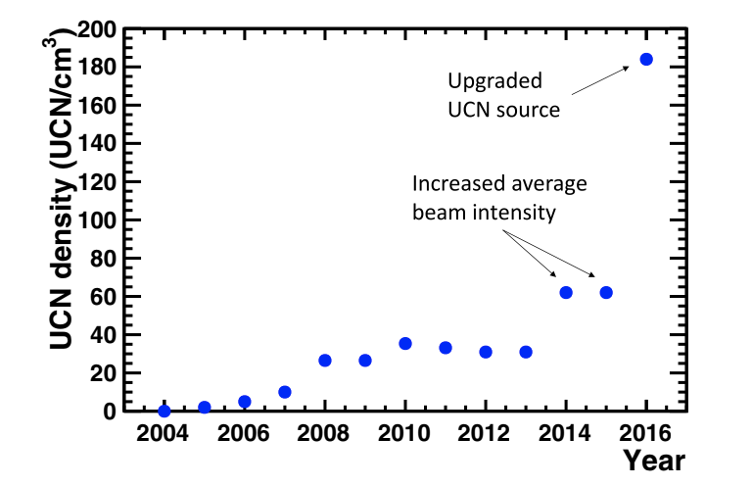
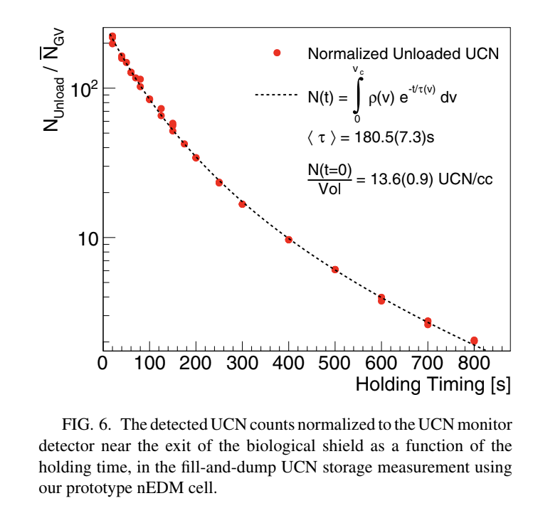
N ~ 39,000 UCN; T ~ 180 s
Ito, et al (2018)

Slide 7
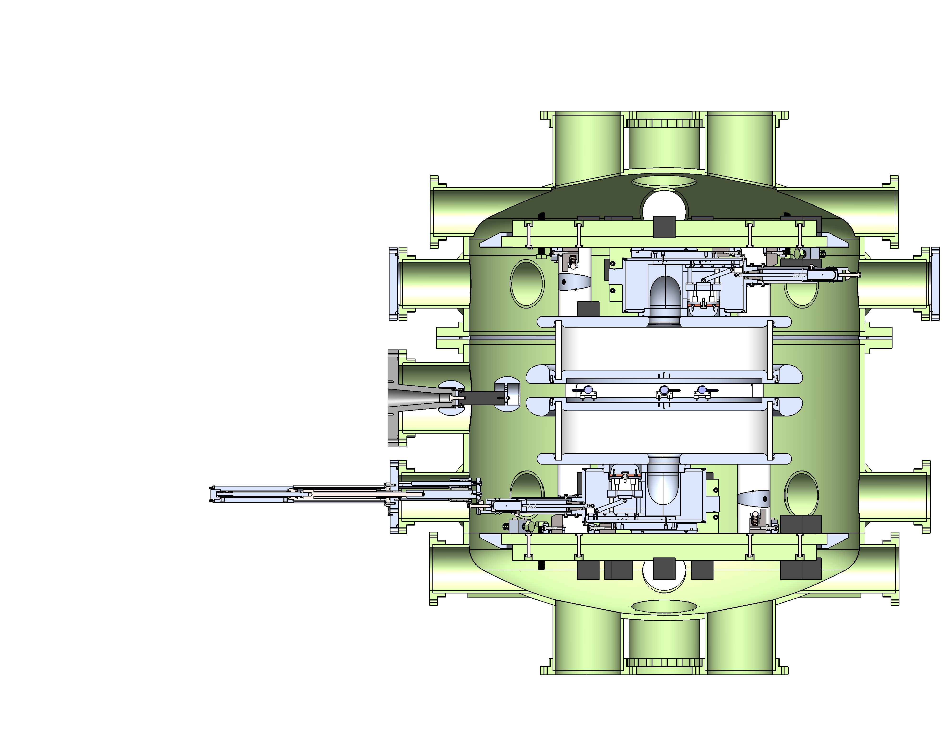
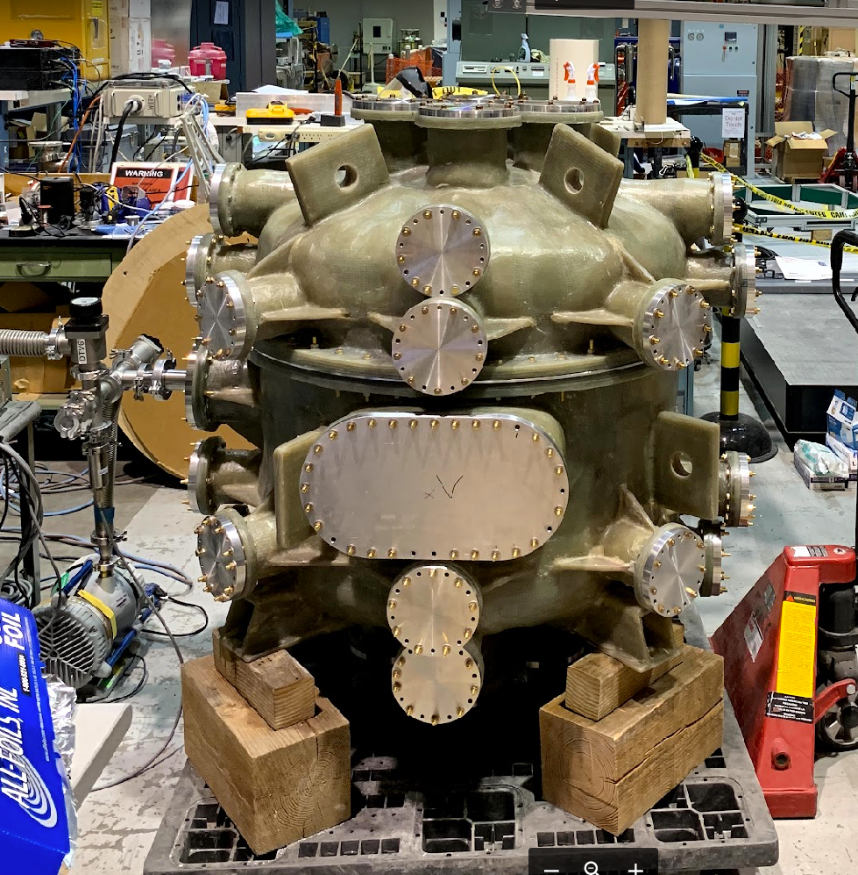
HV Under Development…
External pi/2, Reduce RF interference with Fiberglass Vacuum Chamber
~ 10⁻⁶ Torr before most recent upgrade
Valve
Cell Valve Actuator

Slide 8
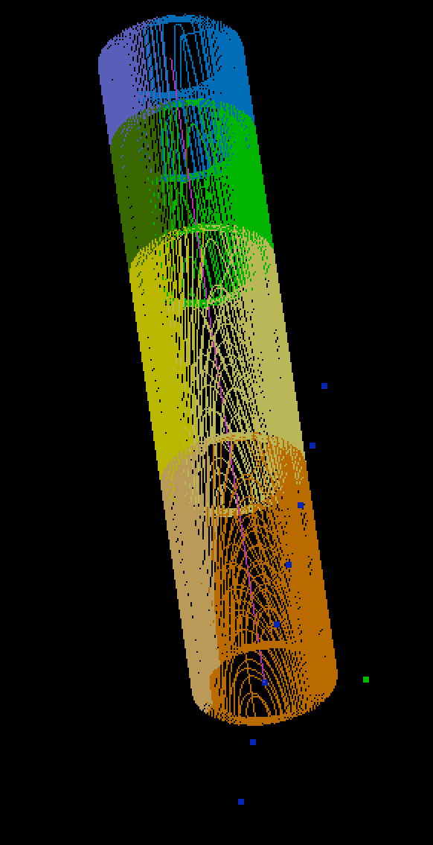
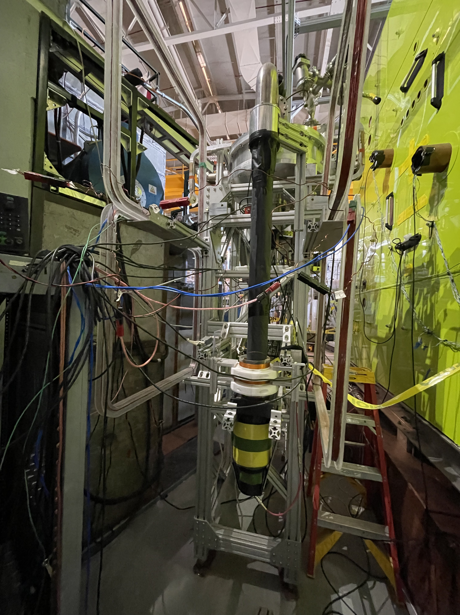
Characterizing 𝛼
Spin Analyzer
Double layer modified cos(𝜃) spin transport coils

Slide 9
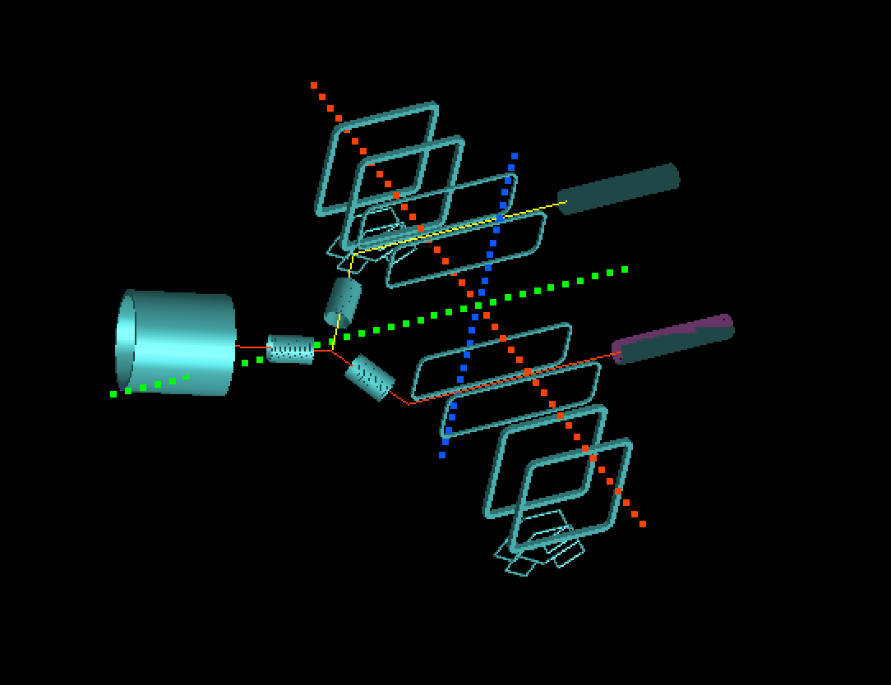
Upcoming UCN Transport Study
STC
STC
MSR
To Spin Analyzer

Slide 10
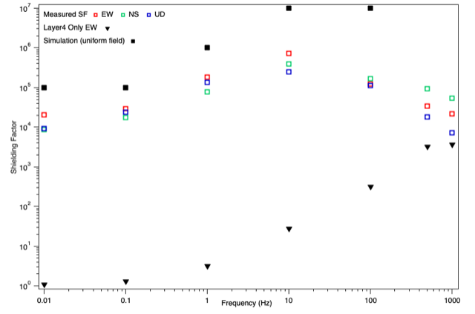
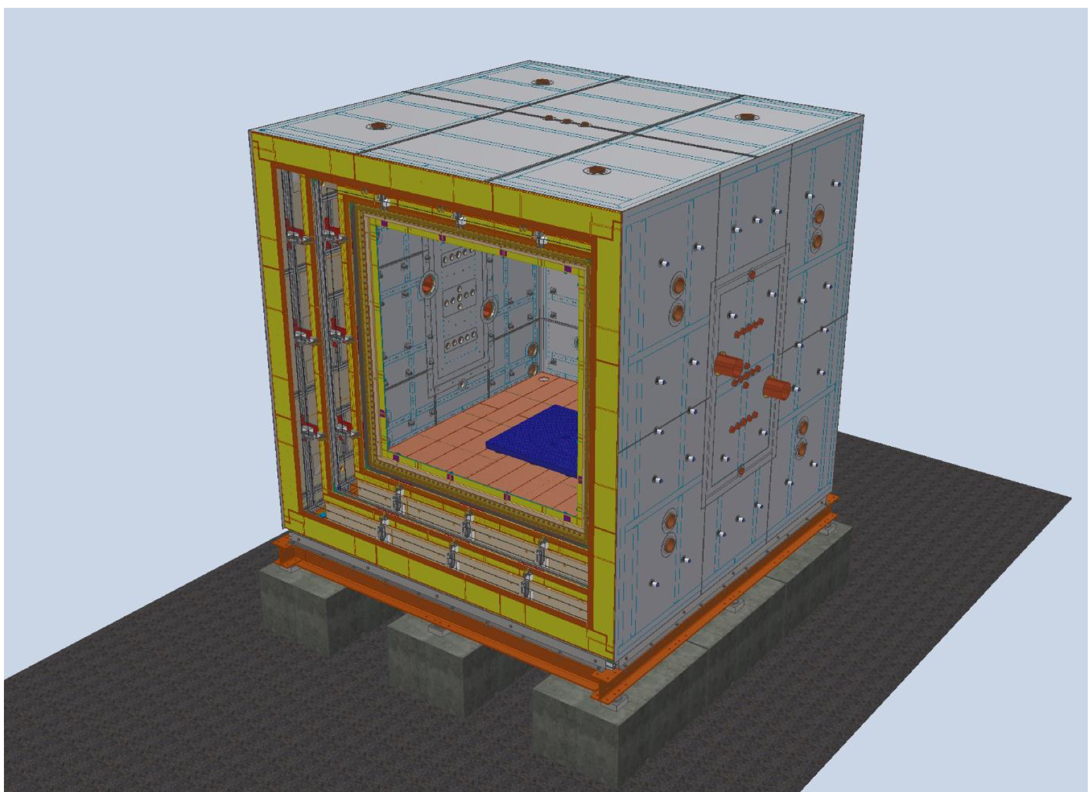
Magnetic Field Requirements (uniformity, stability)
Shielding Factor measured before degaussing
4 mu metal layer, 1 Cu layer MSR
More talks Tuesday and Wednesday!

Slide 11
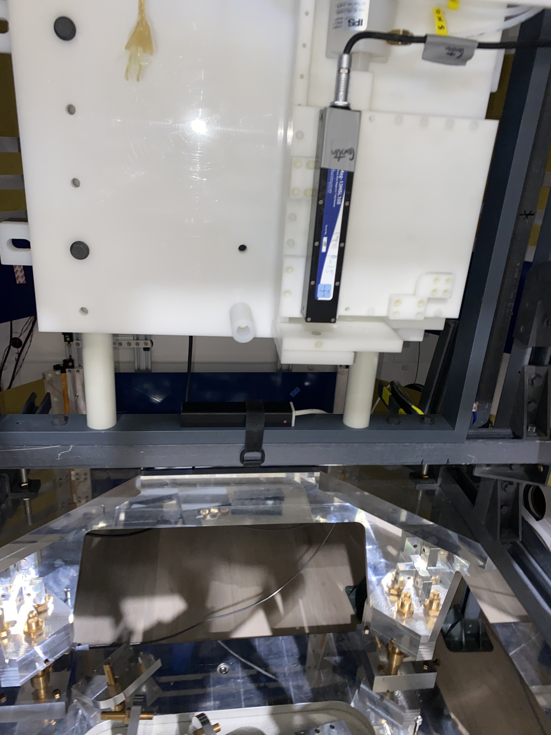
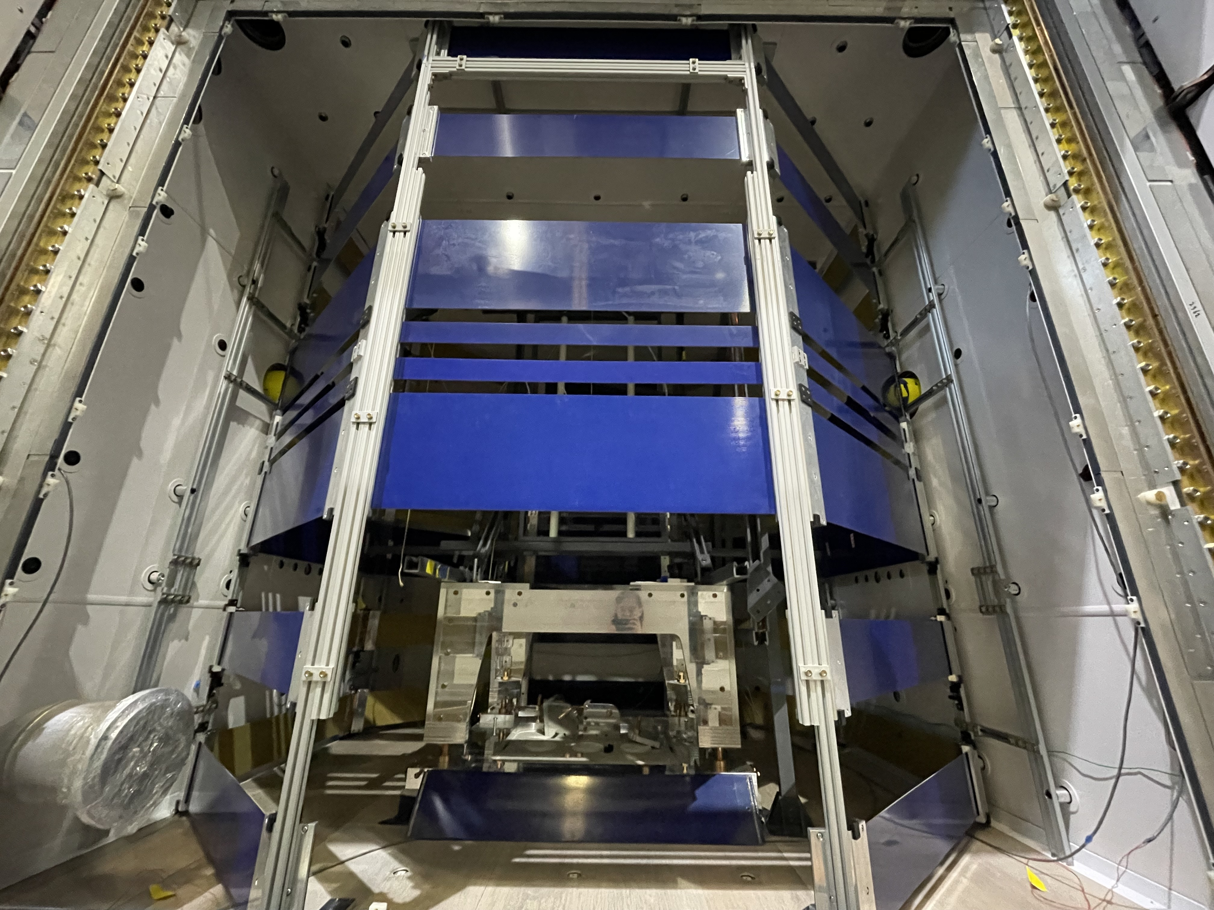
Magnetic Uniformity
Fluxgate Flipper to characterize MSR and B0 performance, plus mapping
Octagonal B0 coil made of PCBs

Slide 12
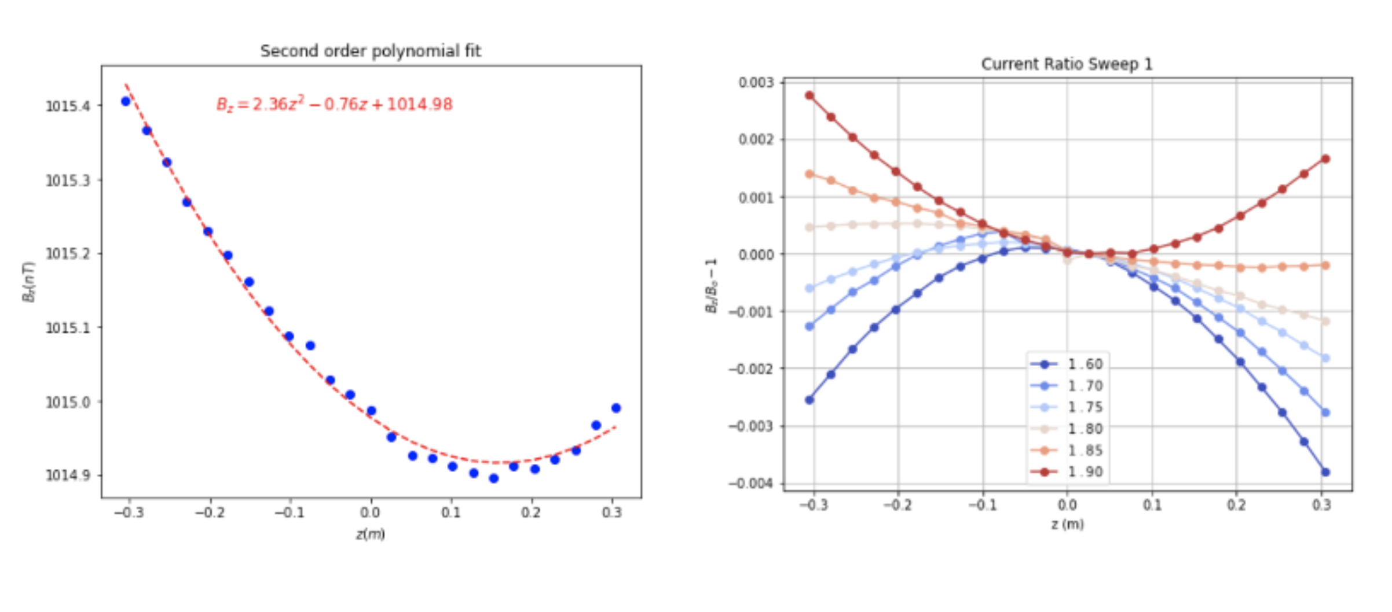
First tests of B0 performance
More Details Wednesday!

Slide 13
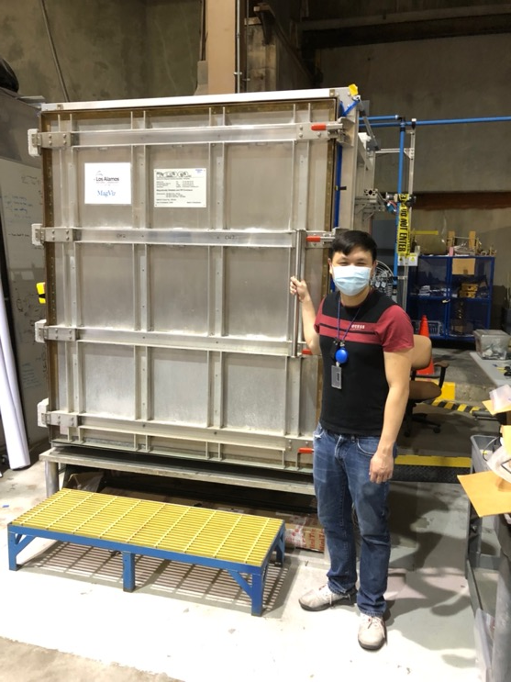
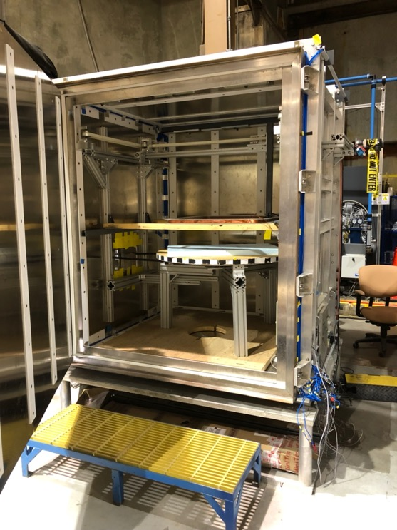
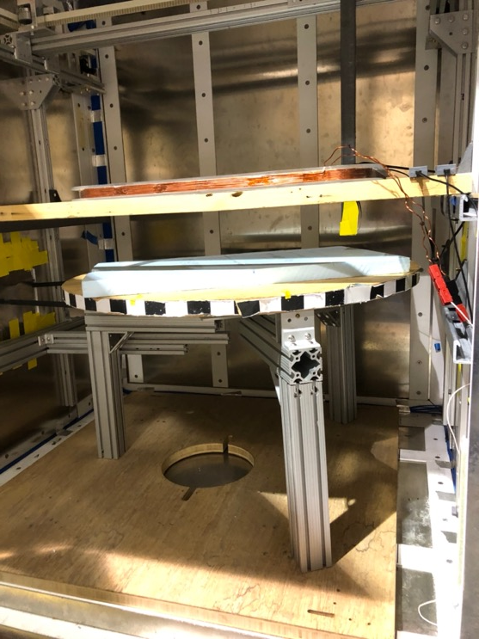
Magnetic Contamination Scanning
Pictured: Doug Wong

Slide 14
Magnetic Contamination Scanning

Slide 15
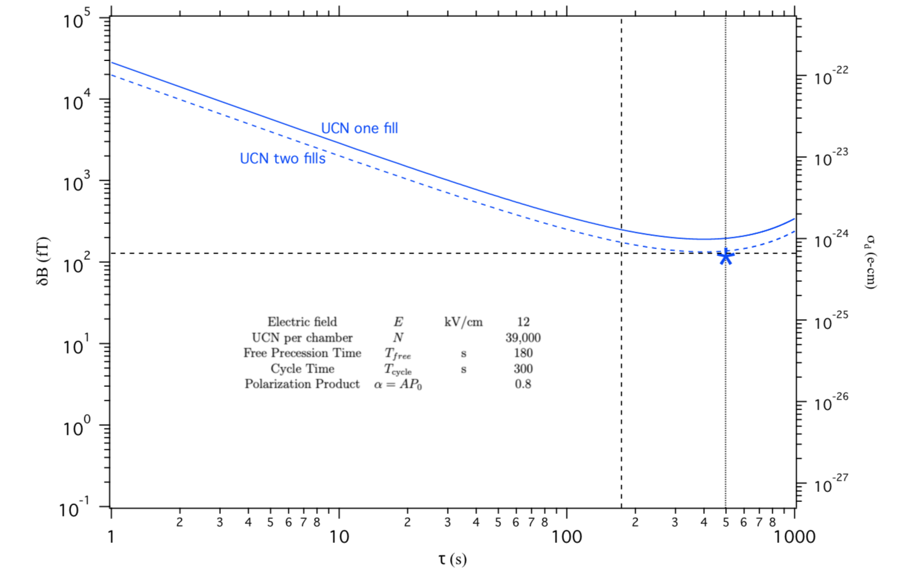
Magnetic Field Stability
Combination of OPMs and Hg magnetometry
Magnetometry Requirement: ~ 150 fT for 480 s

Slide 16
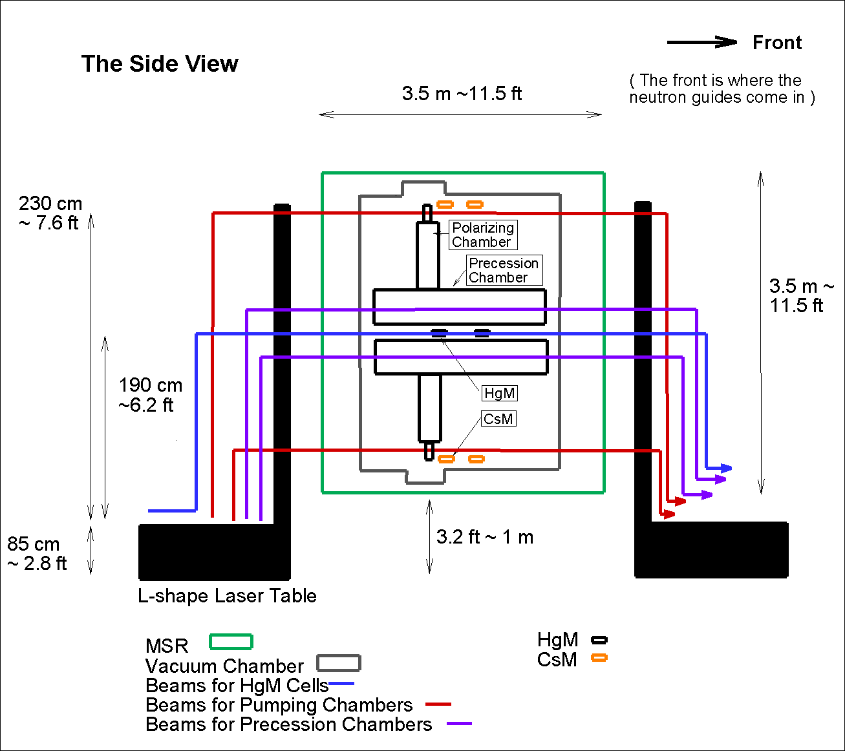
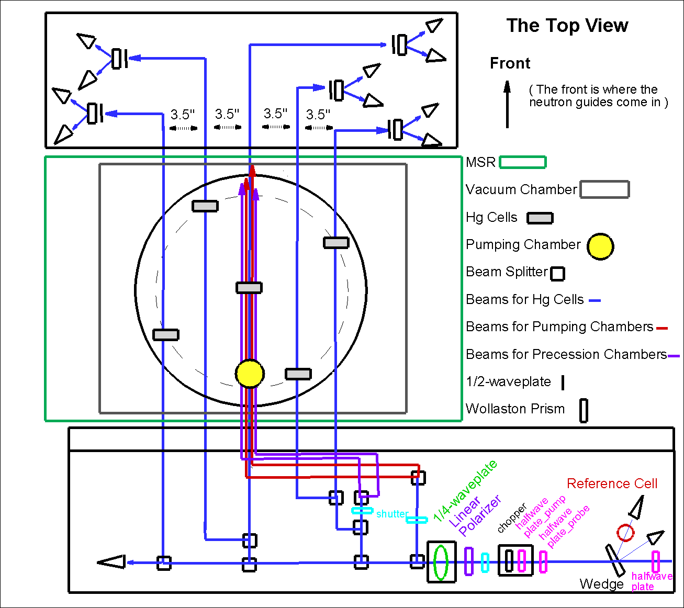
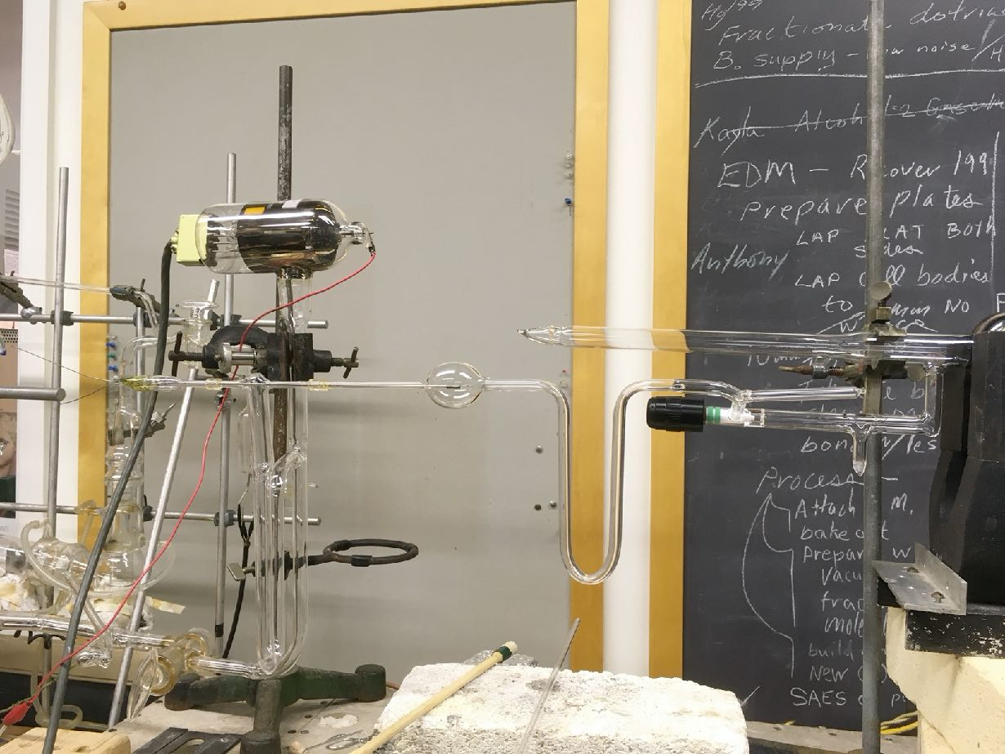
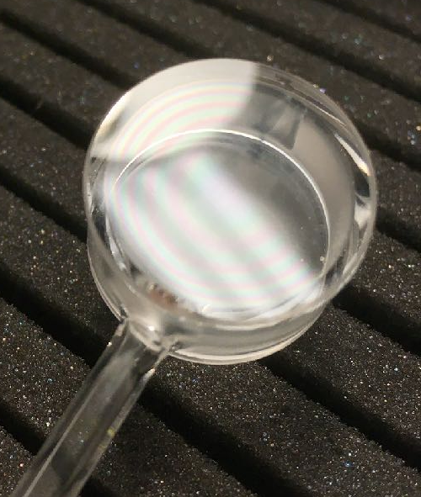
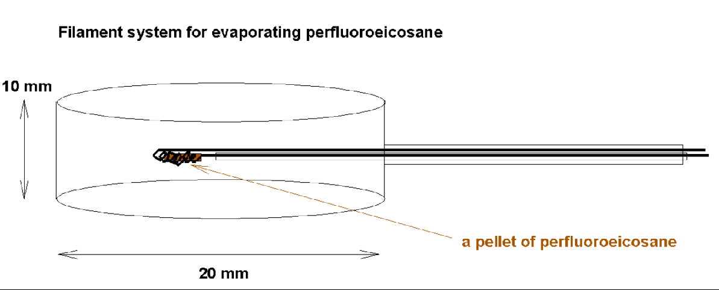
Hg-199 (co)magnetometers
Perfluoroeicosane (C20F42) as the wall coating towards the HV mercury cell
  Reference cell with natural Hg and Helium for feedback laser signal
Design and fabricate the feedback locking circuit so the laser locks at two frequencies during the pump and probe phases with a Hg reference cell.
More Tuesday!

Slide 17
Optically pumped alkali magnetometers
(Rb OPMs)
Collaboration with T. Kornack, M. Limes
Averaging noise
60 Hz
Drift

Slide 18
Coming Soon…
Temperature Control for MSR
Refined FEW studies to understand shielding factor/layer
Magnetic Contamination Scanning Upgrades: sensitivity better than 0.1 nT
NiP and NiMo → DLC for HV electrodes
First nEDM measurements!

Slide 19
Thank You

