Slide 1


Design Status of a New Research Reactor in Japan
nEDM2023 - The 5th Workshop on Searches for a Neutron Electric Dipole Moment
2023-11-07
T. Higuchi, M. Arai, M. Hino, M. Sugiyama, N. Sato,
Y. Kawabata, Y. Abe, R. Nakamura

Slide 2
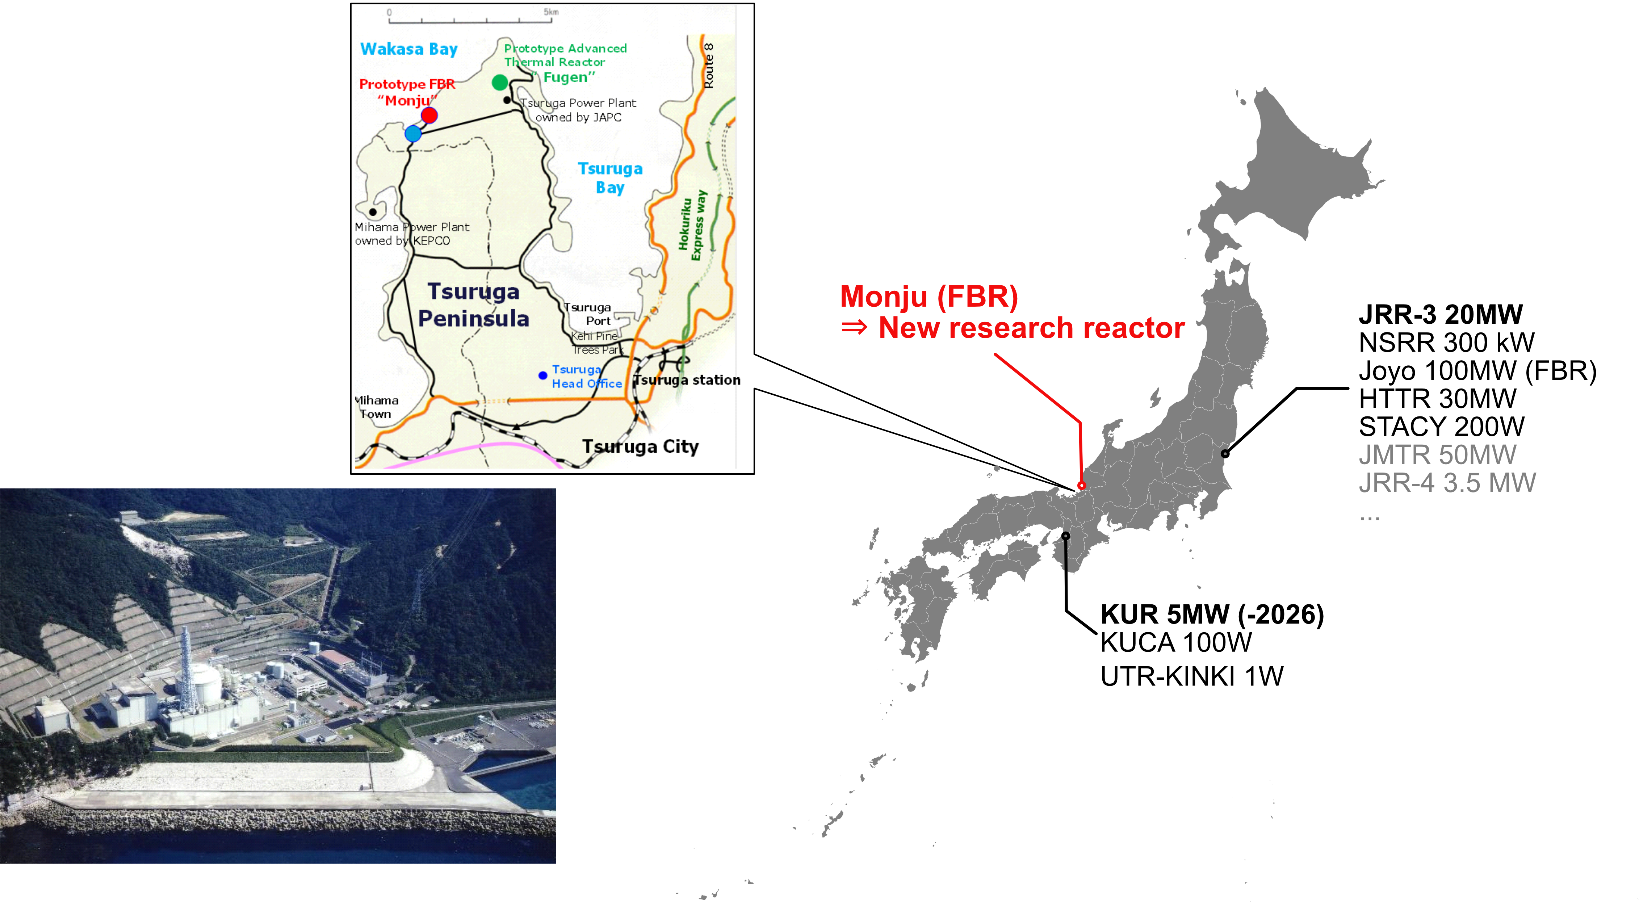
Research reactors in Japan

Slide 3
Background
2016.12: Decision by the government to build the new research reactor
  Decided decommission of Monju and construction of the new research reactor on the same site
2017-2019: Government-led opinion survey
  Survey conducted by the Ministry of Education, Culture, Sports, Science and Technology (MEXT) in an expert committee consisting of various stakeholders
2020.09: Baseline of the reactor defined, call for conceptual design
  Medium-power (10 MW) for wide applications from basic science to industrial uses
  Expected to contribute to the local community, be a core base in the western Japan for nuclear research and human resource development
  Public call by MEXT for conceptual design studies and related researches
2020.11 : Conceptual design project started (JAEA, Kyoto U., U. Fukui)
2020.12 : JAEA selected to be a lead implementer of the project
2023.03 : Shifted to detailed design phase for application of installation license

Slide 4
Medium thermal power selected
Reactor Type | Zero power | Low power | Medium power | High power
Thermal Output | < 10kW | < 500kW | < 10MW | > 20MW
Reactor Physics Study | O | X | X | X
Neutron Science | X | O | O | O
Industrial Application | X | X | O | O
Education | Scientist | Operator | Operator | Operator
Location Applicability | O | O | O | X
Typical # of users (persons x days) | KUCA 1,000 | UTR-KINKI 1,200 | KUR 5,400 | JRR-3 22,500
Medium-power reactor (10MWth) was selected, which can be applied widely from academic to industrial application with a substantial number of users.
Regulatory definition by the Nuclear Regulation Authority of Japan (based on IAEA):
Medium power: 500 kW to 10,000 kW

Slide 5
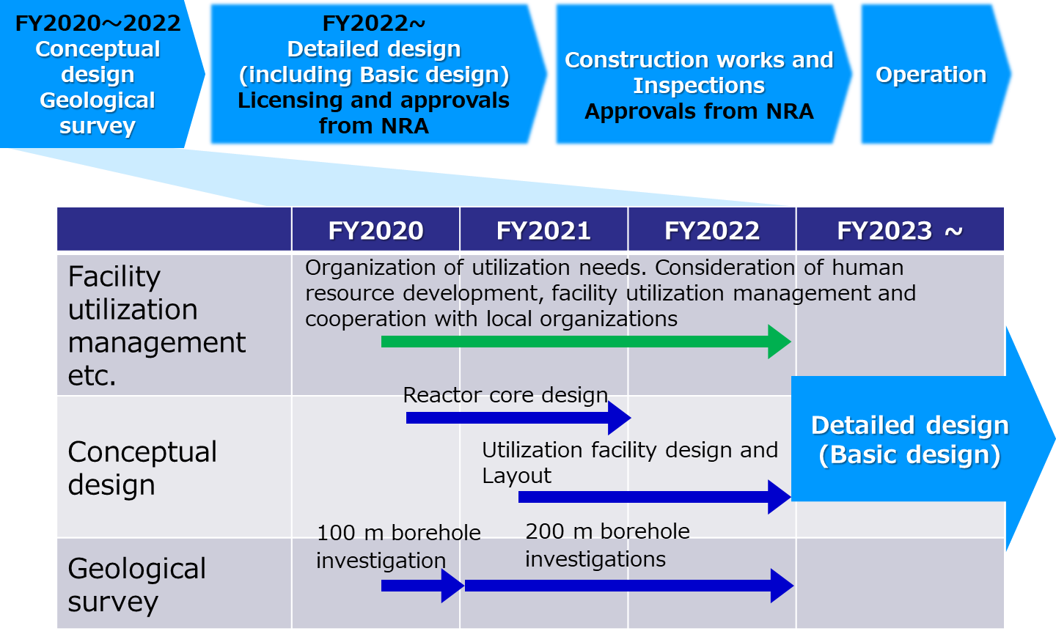
Timeline

Slide 6
Design policies
Enhanced safety performance
    Minimize the potential hazard
    Multiplexing and diversification of safety functions
Economical design
  Apply existing and proven technologies
  Reduction of construction, operation, and maintenance costs
Ensured operation stability (high operation uptime)
  Minimize scrams, prevent troubles by design
  Simplify the maintenance to shorten inspection period
Improved user convenience
  Reasonable arrangement of user accessibility, easy handling of user equipment, and enhancement of available space
Conventional and proven fuel assembly design
    Conventional MTR-type fuel assembly to achieve economical design and short time of approval process
Advanced and improved experimental facilities including the Cold Neutron Source (CNS) and peripheral facilities

Slide 7
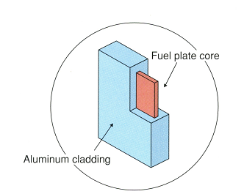
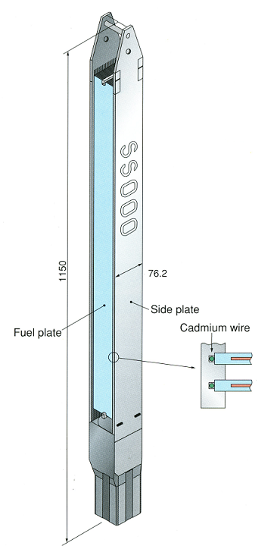
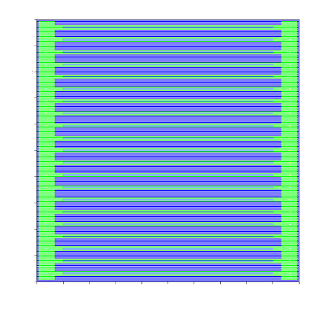
Fuel element
Standard MTR-type
  Standard fuel material with enrichment no higher than 20%
  Based on MTR-type fuel assembly of the existing research reactors (e.g. JRR-3, JMTR)
0.51mm×62mm×750mm（20% enriched ²³⁵U）
Size |  | 76.2 × 76.2 × 1150 mm
Nuclear Fuel |  | U₃Si₂
²³⁵U enrichment |  | Approx. 20 wt%
²³⁵U content |  | Approx. 472 g
Uranium density |  | 4.8 g/cm³
Fuel meat | Thickness | 0.51 mm
 | Width | 62 mm
 | Length | 750 mm
Cladding |  | Aluminum alloy
Cladding thickness |  | 0.38 mm
Fuel plate | Thickness | 1.27 mm
 | Width | 71 mm
 | Length | 770 mm
Number of coolant channel |  | 20
Coolant channel thickness |  | 2.35 mm (×20)
76.2 mm
Specification of JRR-3 fuel assembly

Slide 8
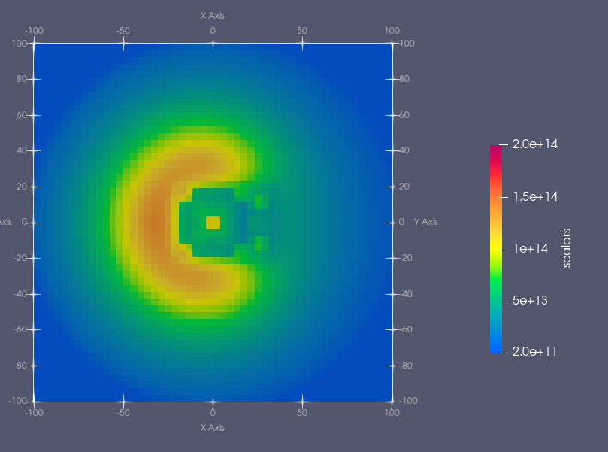
Arrangement of irradiation holes (tentative)
Core configuration of irradiation holes
  Open pool-type reactor with a central core and heavy water reflector
  The core has 16 standard fuels, 4 control rods with follower fuels, and 5 irradiation holes in 5x5 grids.
  Large diameter (φ100mm) irradiation holes next to the fuel core.

Slide 9
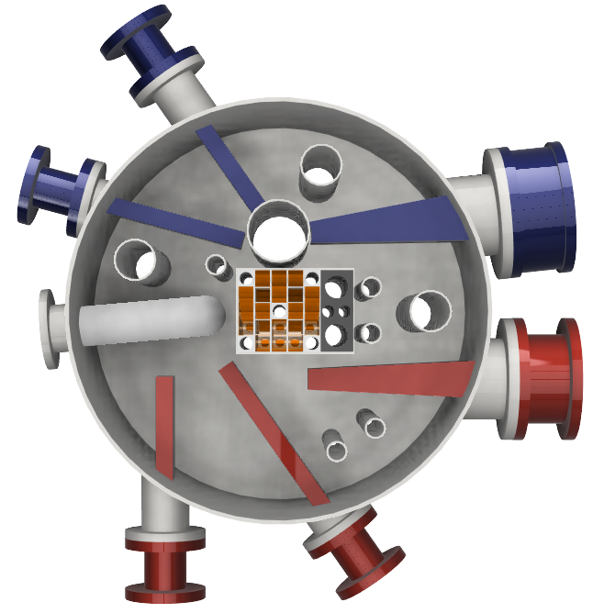
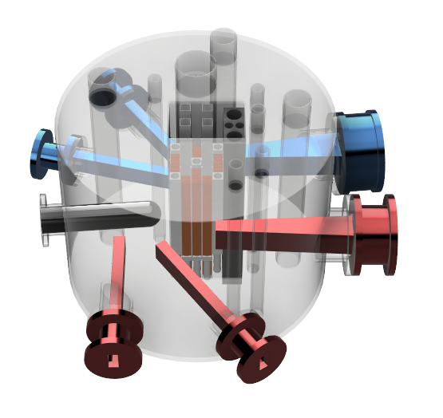
Arrangement of neutron beam lines (tentative)
Arrangement plan of the Cold Neutron Source (CNS) and neutron beam
  Main objective : Utilization of neutron beams
  Advanced design for CNS
  Sufficient space to locate facilities and experimental devices in the reflector
CNS

Slide 10
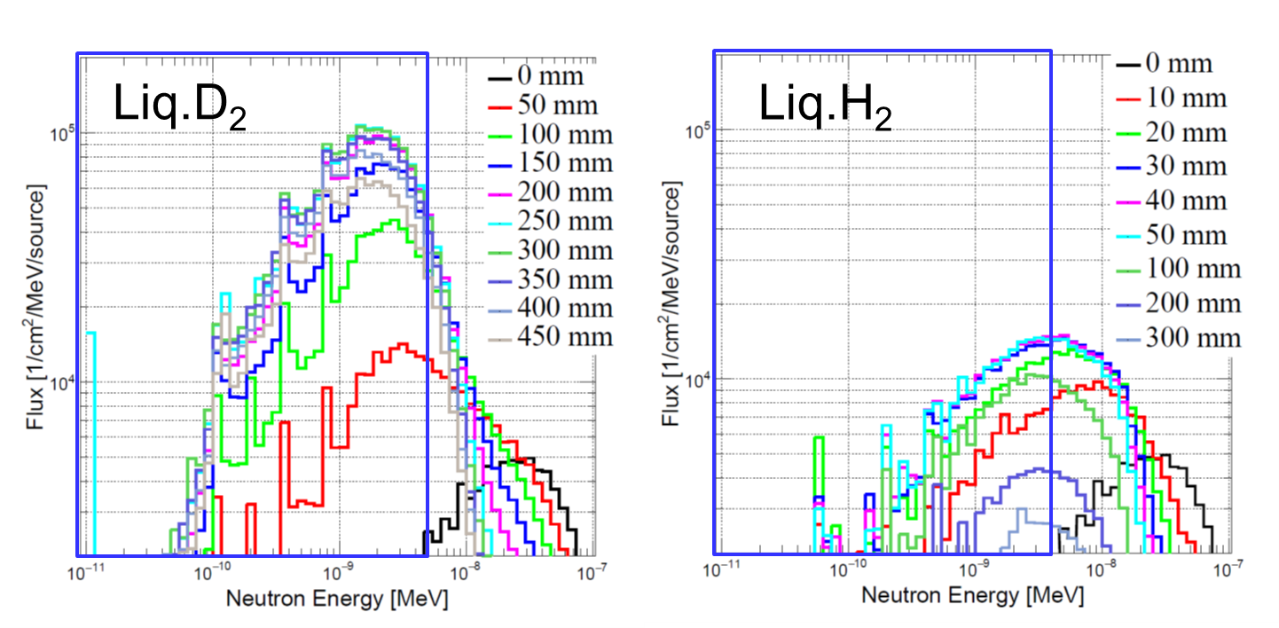
Simple simulations of the CNS moderator
The first step of simulations with a simple geometry
  2 MeV fast neutrons from outside to the inside of the sphere
  Moderator material Liq. D₂ (100% ortho) or Liq. H₂ (100% para)
  Size of the sphere of D₂O + cold moderator fixed to 500 mm radius, swept moderator thickness
500mm
PHITS (Ver3.23)

Slide 11
Prioritized neutron instruments
Small-Angle Neutron Scattering Instrument
Neutron Imaging Instrument
Analysis of forms and sizes of collective structure of atoms or molecules
Visualization of internal structure and phenomena of machines, piping, plants etc.
Neutron activity analysis instrument
Analysis for microelement by non-radioactive assay
JRR-3 SANS-U
Ge detector
JRR-3 TNRF
KUR Pneumatic tube
Neutron Diffraction Instrument
Neutron Reflectometer
Crystal structure analysis
Structural analysis of materials interfaces and surfaces
JRR-3 HRPD
JRR-3 MINE

Slide 12
Future timeline
FY2019-2022
conceptual design
FY2022～
Detailed design
Construction works and inspections
Operation
Expected timing of
application for installation license
is to be presented in 2024
Item | Detail design Ⅰ | Detail design Ⅱ
Licensing
Design for installation approval
Design for engineering approval
Civil engineering for the administrative building (licensing not required)
Application
(Installation)
Approval
Application
(Engineering)
Approval
・Core component
・Safety design
policy formulation,
etc
Systems for
Main Unit, Cooling, Sensing and Control, Disposal, Radiation Control, Spent Fuel Storage, Utility, etc
Construction start

Slide 13
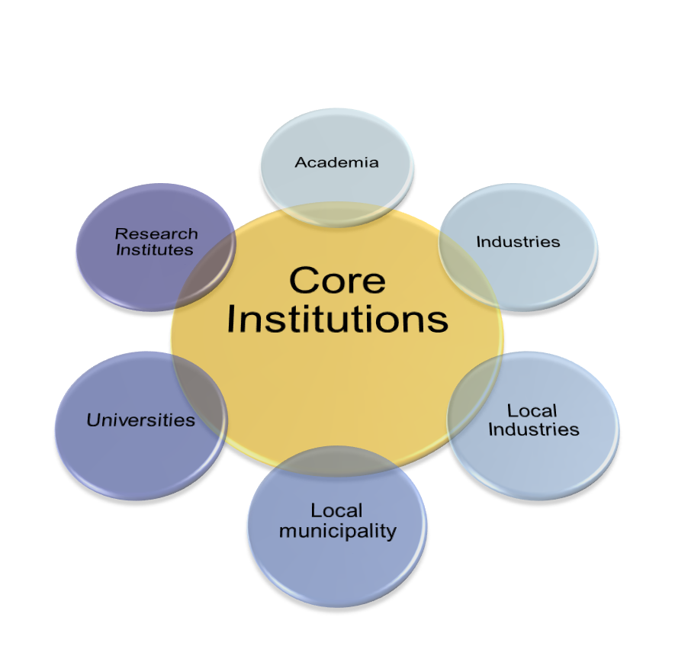





Consortium of stakeholders
Signing ceremony on May 8, 2023
JAEA
  Design, installation and test operation
Kyoto University
  Aggregation of wide-range applications and provision of services based on the experience of KUR operation
University of Fukui
  Cooperation with local universities, research institutes, companies, etc. in Fukui
Role of Core Institutions
Steadily advance the project by the core institutions with consideration of wide range opinions from academia, industry, local organizations, etc.

Slide 14

Acknowledgements
MEXT-commissioned project: “Investigation on conceptual design and project management schemes for the new research reactor at the Monju site”

Slide 15
How about UCN?

Slide 16
Consideration for a UCN Source at the New Research Reactor
nEDM2023 - The 5th Workshop on Searches for a Neutron Electric Dipole Moment
2023-11-07
T. Higuchi, S. Kawasaki, K. Mishima

Slide 17
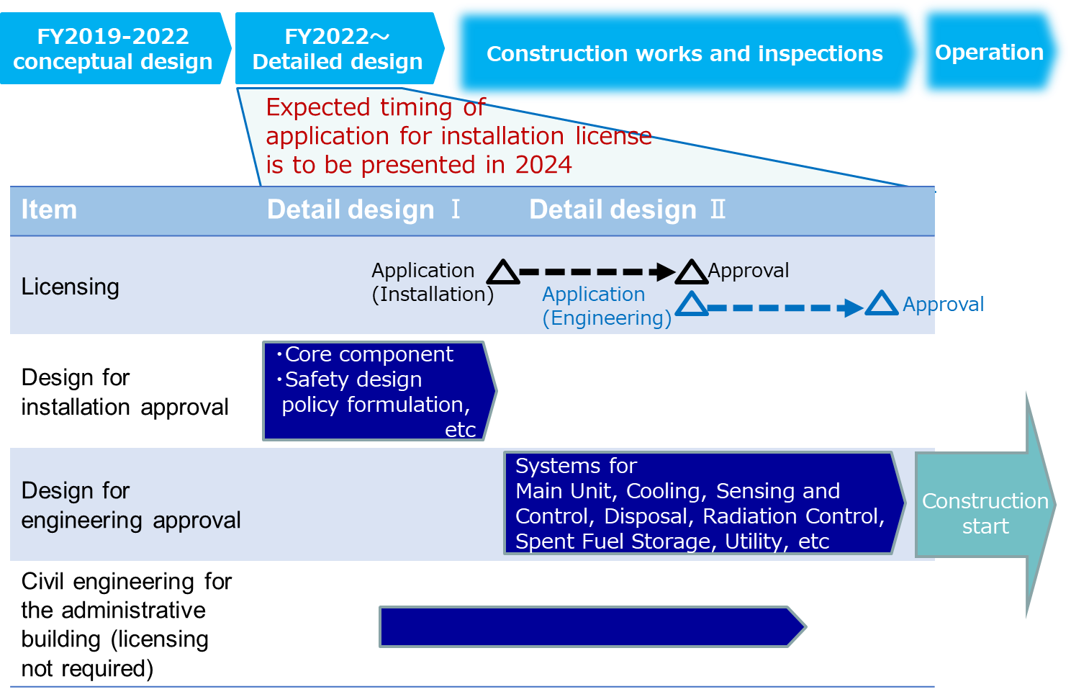
The new research reactor status
The current design efforts focused on the core and the core building (“detail design I”)
  Fuel arrangements, irradiation holes, # of extraction ports…
  → these need to be fixed to apply for legal permission of the construction
Everything downstream is still flexible!
  Possibility of proposing new ideas during
  the long “detail design II”
Reactor-based UCN source is under consideration

Slide 18
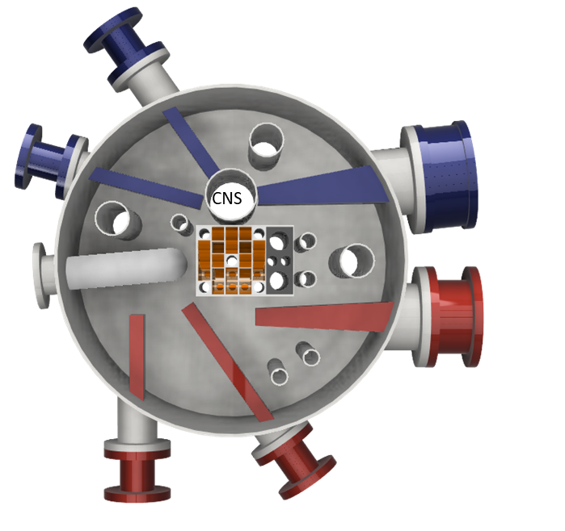
Boundary conditions
sD₂ or He-II ? ⇒ He-II
→ sD₂ near the core is difficult (we don’t want to make ambitious challenge around the core)
We want not to delay the entire reactor due to the UCN source
Arrangement of extraction ports:
  Still flexible. The only thing we need to decide imminently is the
  size of the beam port
Our proposal:
He-II UCN source with an advanced cold neutron optics

Slide 19
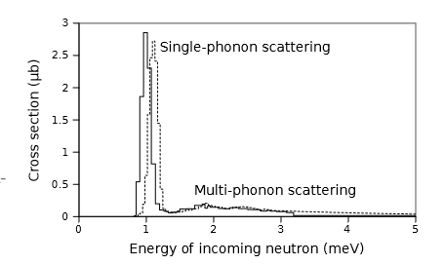
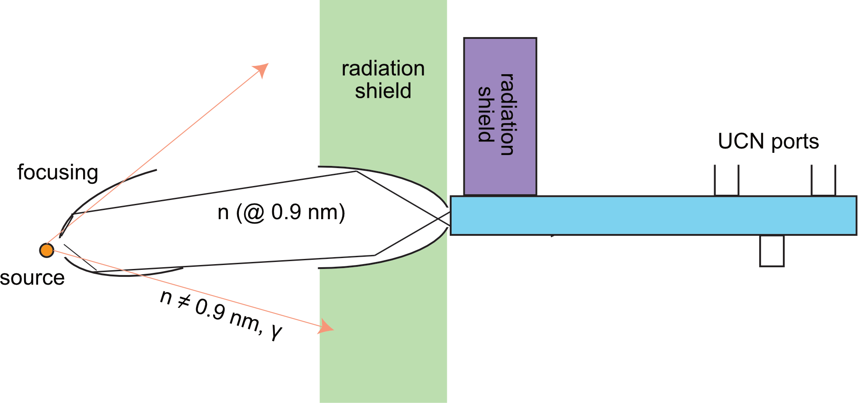
Concepts
Design neutron optics that has large solid-angle coverage by a high-m super mirror
  Critical cold-neutron wavelength for UCN production: ~1 meV (0.9 nm)
  Maximize the solid angle from the source for 0.9 nm neutrons by the use of high θc supermirrors
P. Schmidt-Wellenburg, et al., Phys. Rev. C 92 (2015) 024004
E. Korobkina et al., Phys. Lett. A 301 (2002) 462 – 469.

Slide 20
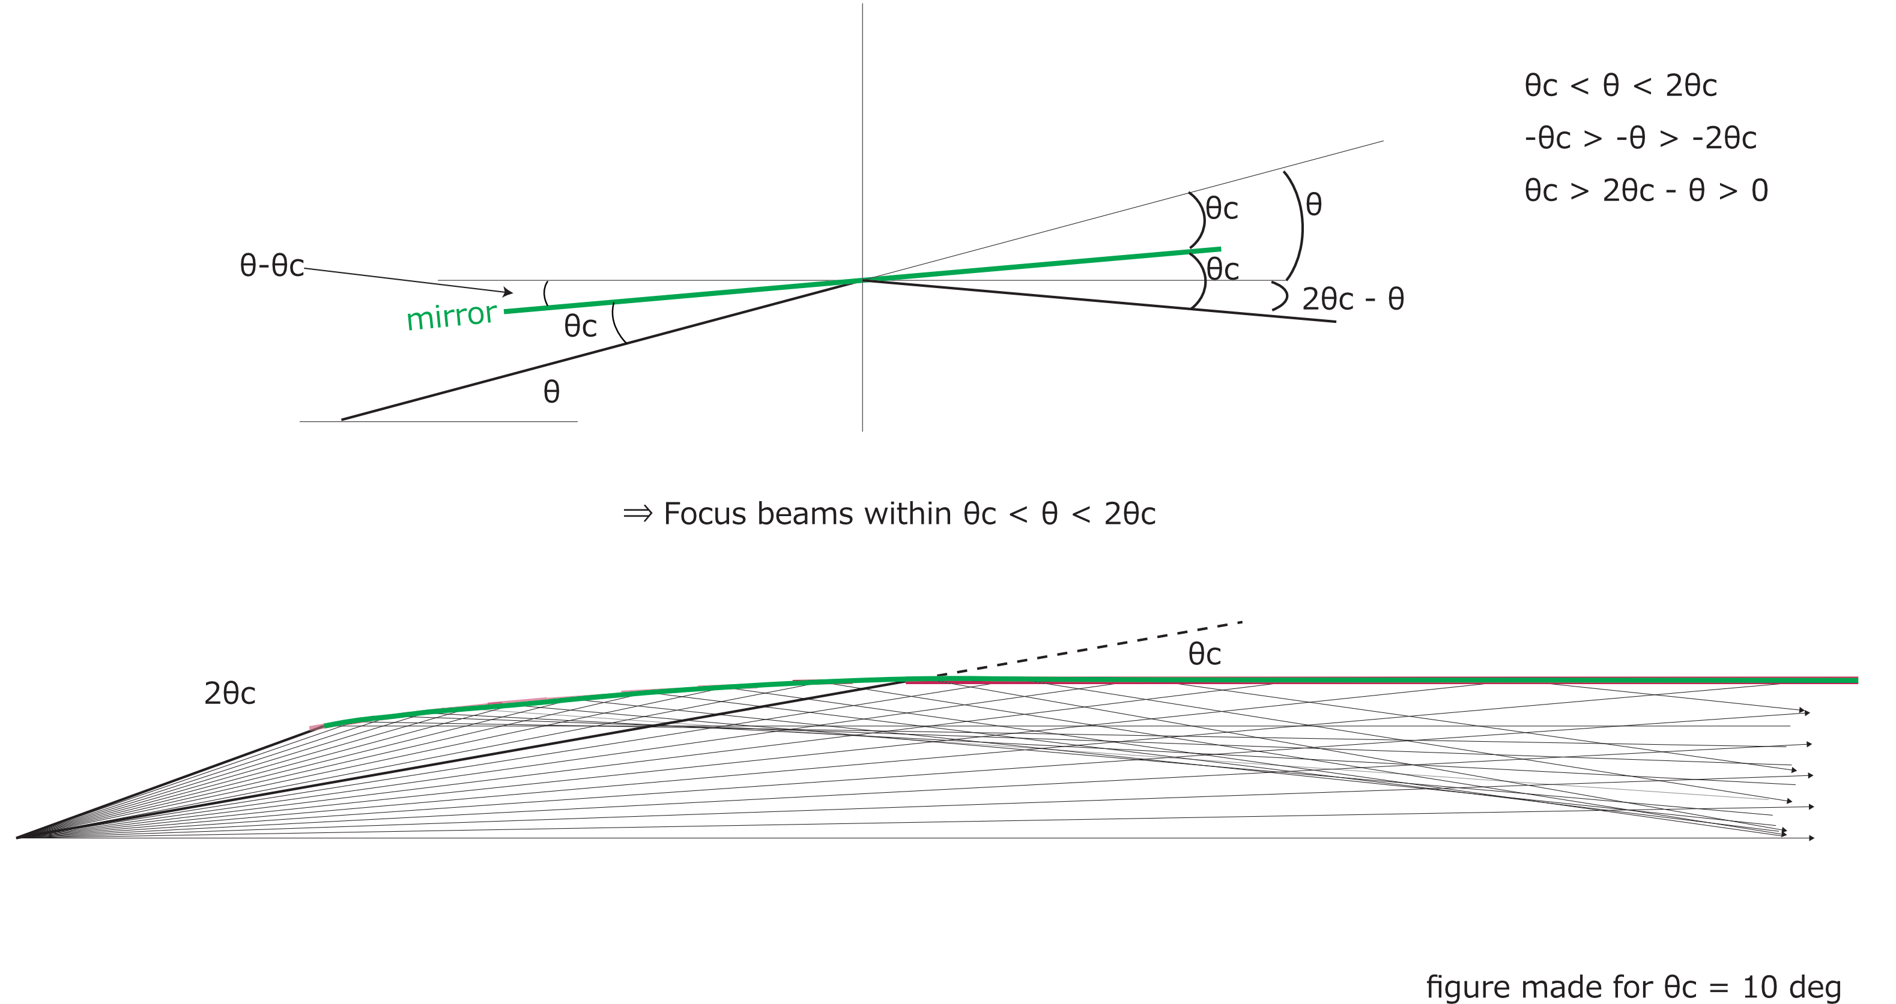
Idea of the focusing optics
By combination of mirrors that form θc to each other, angle up to 2θc from the source can be covered

Slide 21
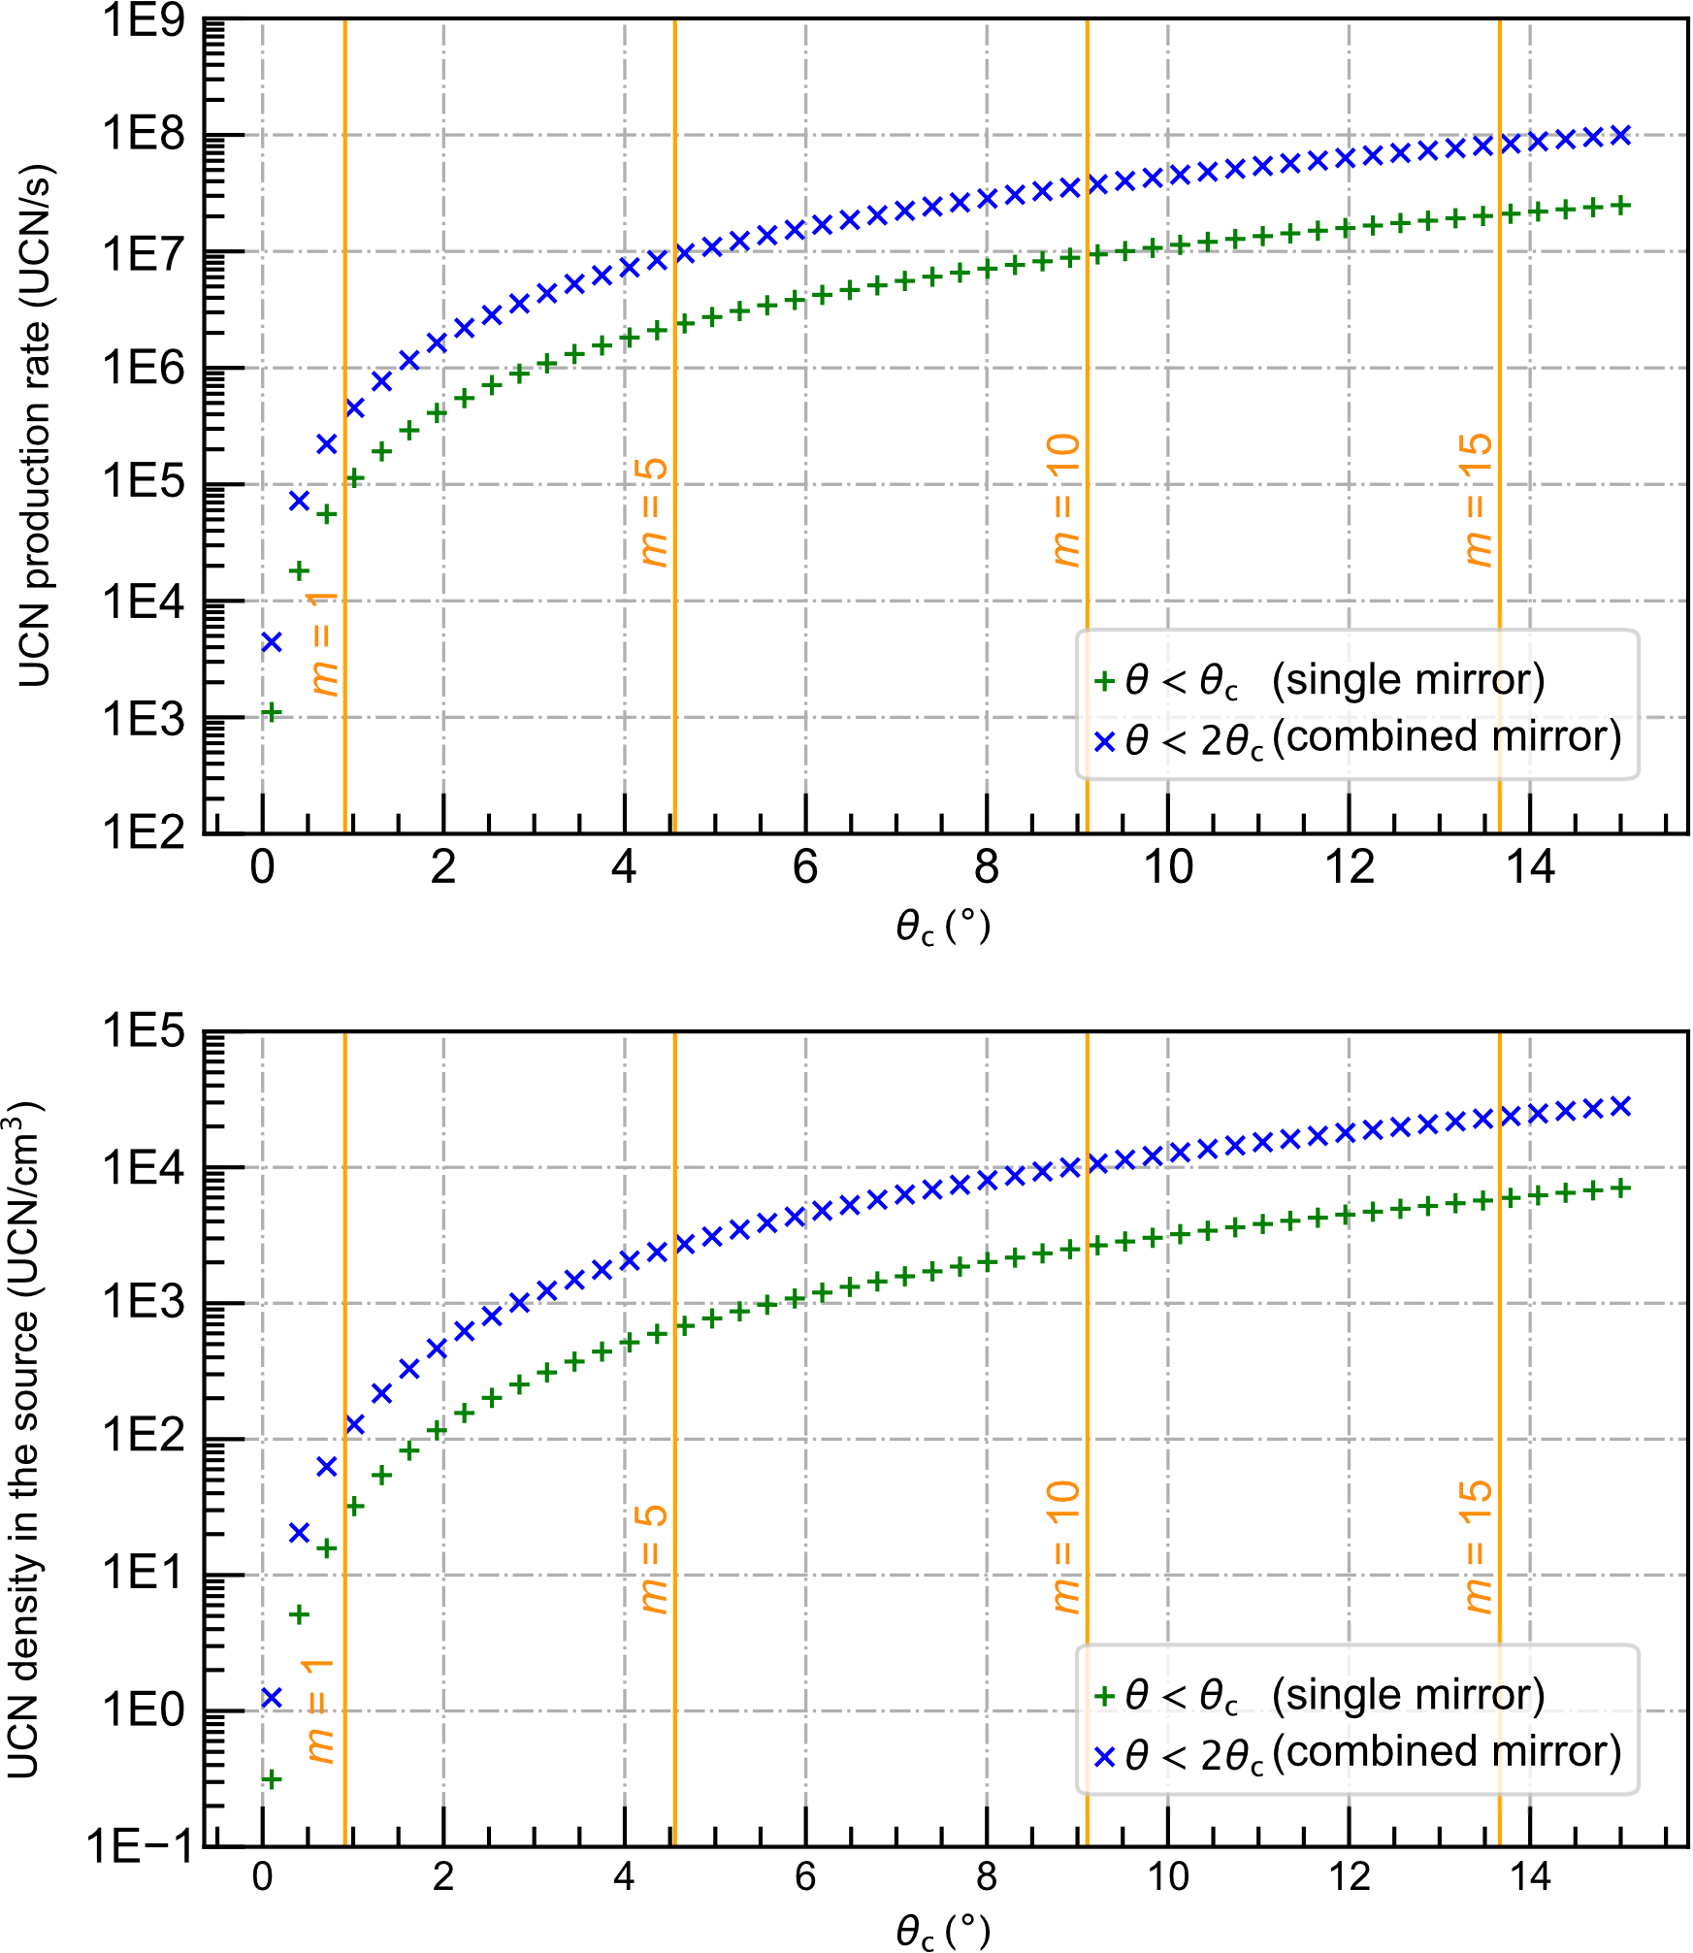
Simplistic estimates
Assumptions:
  UCN production cross section at 1 meV: 1. 5 μb
  Cold neutron flux: 1.0×10¹⁰ n/cm²/s/sr
  Supermirror reflectivity:1
  He-II volume: 350 L (Φ=30 cm,, L = 500 cm)
  He-II density: 0.145 g/cm³
  UCN lifetime: 100 s
Expectation with m=5 supermirrors,
- production rate: ~10⁷ UCN/s
- source UCN density: ~ 1x10³ UCN/cm³

Slide 22
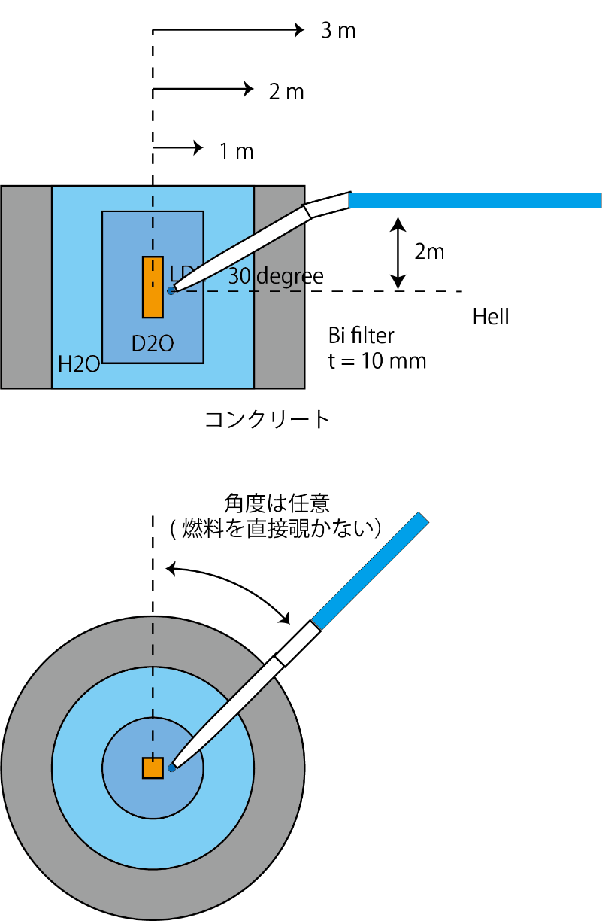
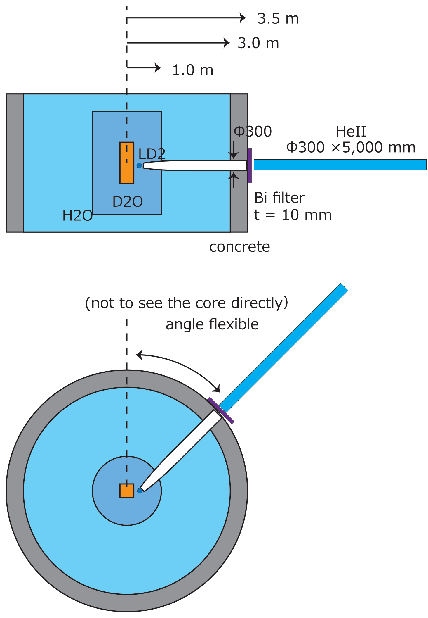
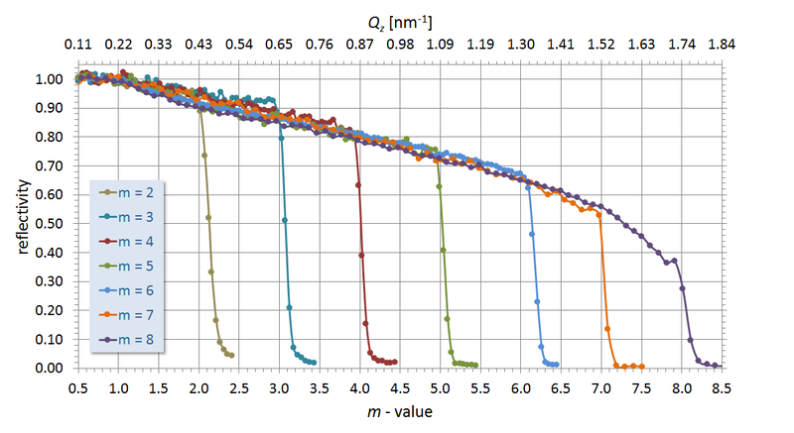
Further considerations
In reality, the supermirror reflectivity decreases at a larger angle
Radiation tolerance of supermirrors: test data acquired at PSI
Temperature dependence of UCN production in He-II
→ The core to He-II distance, heat load from the neutron flux, cryostat cooling power
3D arrangement of the UCN source and ports (higher position: preferrable for UCN experiments and reducing higher-energy neutrons)
Swiss Neutronics (https://www.swissneutronics.ch)

Slide 23
Summary
Opportunities at the new research reactor: most of the elements are still yet to be designed
Possibility of a He-II UCN source with an advanced neutron optics:
  Use supermirrors to maximize the solid angle coverage of 0.9-nm cold neutrons
  Estimates with m=5 supermirrors → 10⁷ UCN/s,10³ UCN/cm³
  Technological improvement of multilayer mirror production may boost the production rate
Interested? → talk to me!
Thank you for your attention!

Slide 24
Backup

Slide 25
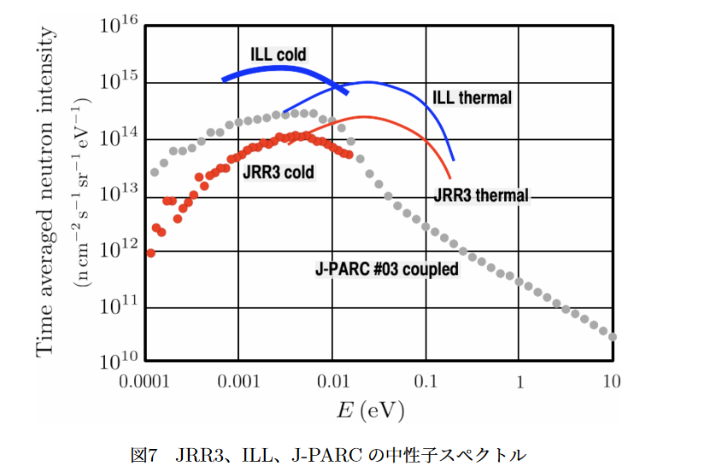
Expected neutron flux
Thermal neutron flux target value: 10¹⁴ n/cm²/s
Cold neutron source at JRR-3 (LH2): not optimized (cold neutron flux lower by a factor of 2 than what should be expected from a thermal neutron flux)
→ By improved CNS, we expect to have a comparable cold-neutron flux to JRR-3

