Slide 1
Update on Characterization of measurement cells for the nEDM@SNS experiment
Clark Hickman
Cole Teander
Santa Fe, November 2023

Slide 2
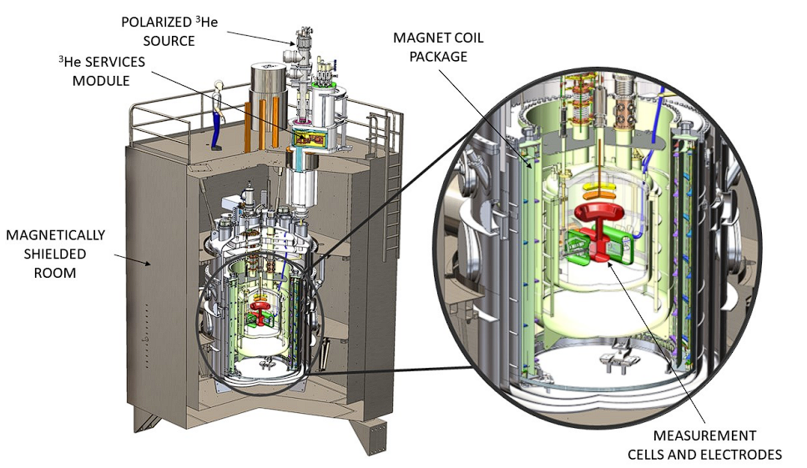
The nEDM@SNS Apparatus
Experimental program goal:
3 * 10⁻²⁸ e*cm (300 live days, 90% CL)
Designed with two measurement cells with opposing electric fields
Produce ultracold polarized neutrons in situ (8.9 A beam that downscatters off superfluid He)
Polarized ³He co-magnetometer used
Background 1/3

Slide 3
Measurement Cell Design Goals
Store ultracold neutrons for >600 sec
Shift wavelength of EUV scintillation photons (80 nm) to blue light for optical fibers to SiPMs (400 nm) with dTPB coating. Optically transparent
Be a dielectric & nonmagnetic
dPS coating to prevent depolarization of UCN and He
Measurement aims
Ultracold neutron storage time
Probe UCN energy dependent effects
𝜏_{st}(s) | 𝜏_{cell}(s)
90 | 100
470 | 1000
555 | 1500
610 | 2000
Relaxation time of polarized ³He in the NEDM cell geometry is ~2.5 e4 s at 330 mK with dTPB-dPS coated acrylic surface, meeting the experimental requirements (Q. Ye et al., Phys. Rev. A 80, 023403 (2009))
Background 2/3
Notes:
Will we have to measure with polarized neutrons eventually to check depolarization characteristics of the cell?
dPS - polystyrene
dTPB - 1,1,4,4-tetraphenyl-1,3-butadiene

Slide 4
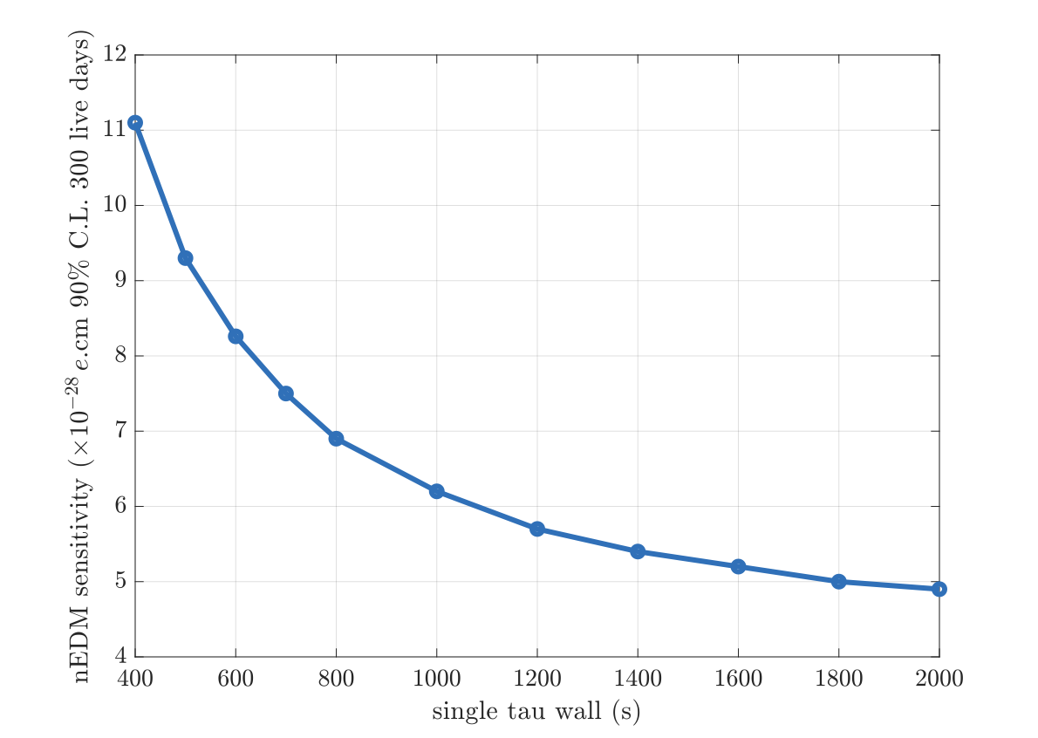
Systematics related to UCN energy
UCN storage time is always E-dependent (1/v wall reflection rate, standard wall loss model, and exasperated by other cell defects (e.g. weak patch))
𝜏 _{storage} @ LANL = 350 s + large weak patch
In nEDM@SNS, τ_{cell}(E) affects UCN spectrum time-evolution both during filling and measurement.
Systematic effects that depend on UCN spectrum:
Time-evolution of UCN gravitational offset frequency shift
v x E field related frequency shifts (E^2 and false EDM)
Once installed in final experiment, very difficult to measure.
𝜏 _{storage} @ LANL = 550 s + large weak patch
𝜏 _{storage} @ LANL = 350 s + no weak patch
𝜏 _{storage} @ LANL = 550 s + no weak patch
Background 3/3

Slide 5
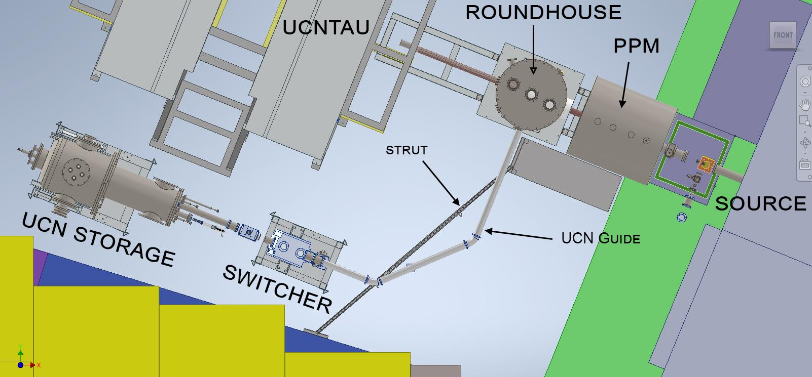
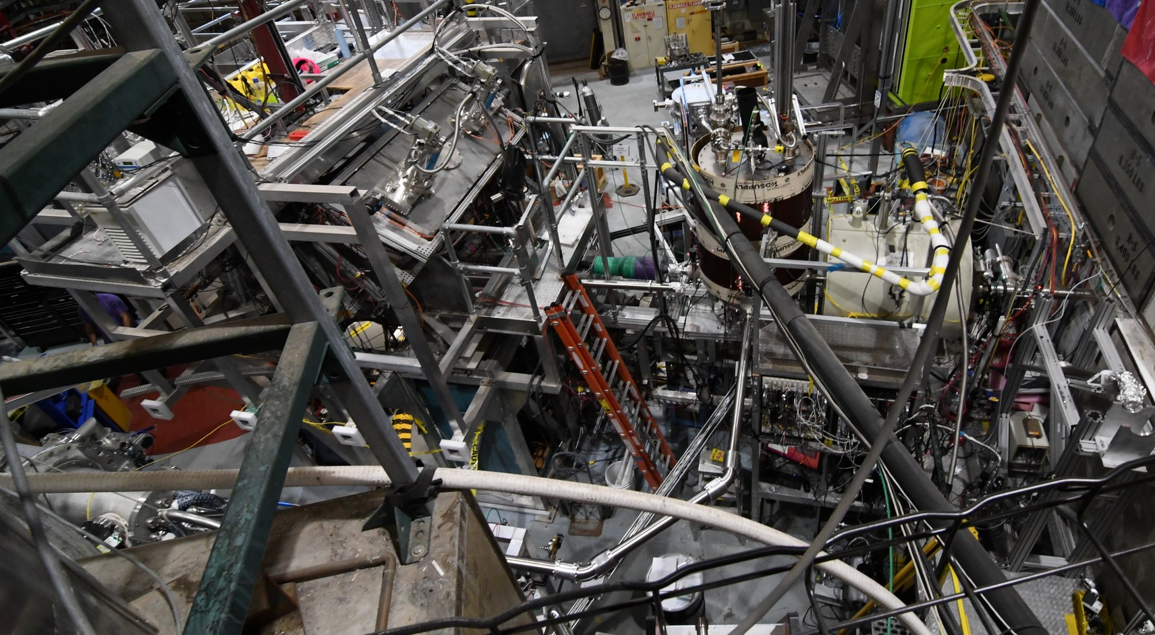
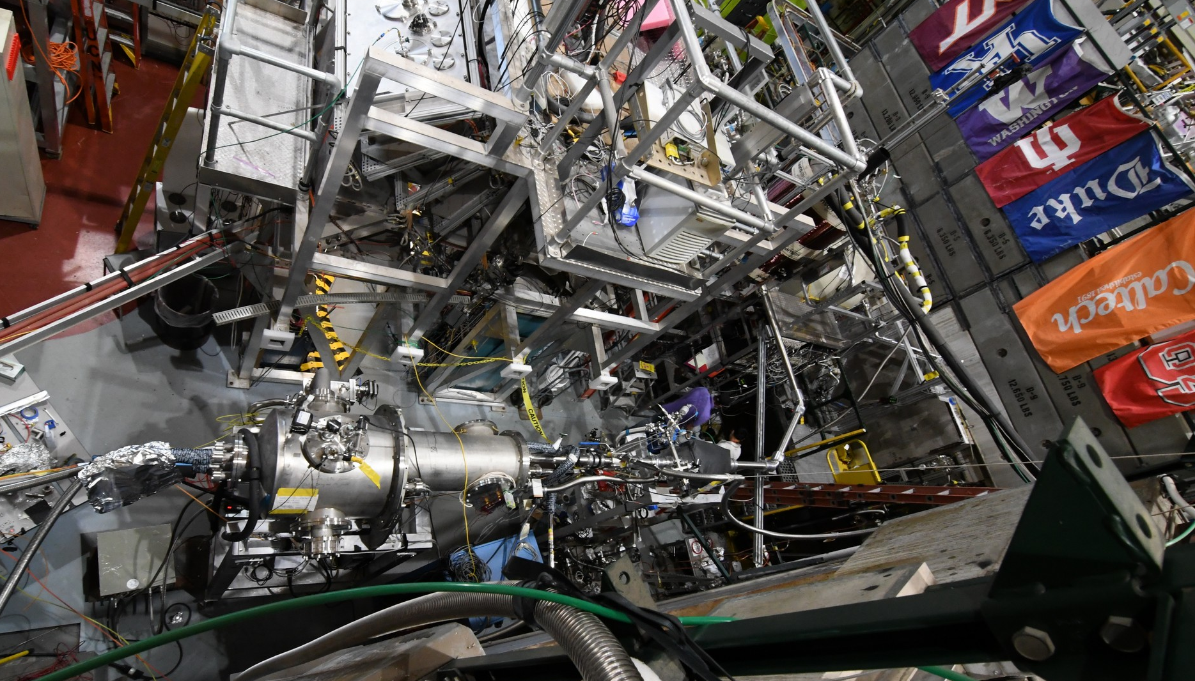
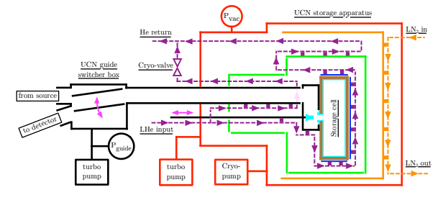
Experimental setup
New “guide gatevalve” here
RH
PPM
UCN storage
switcher
Experiment 1/2

Slide 6
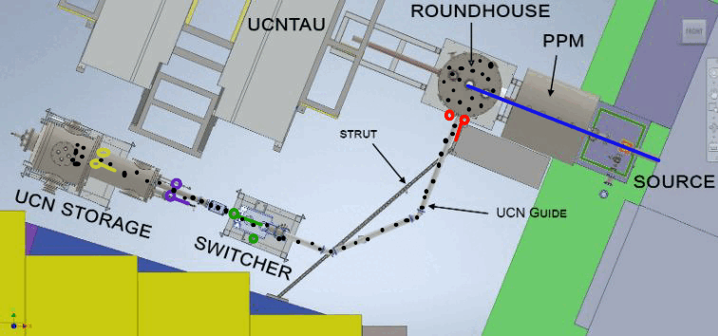
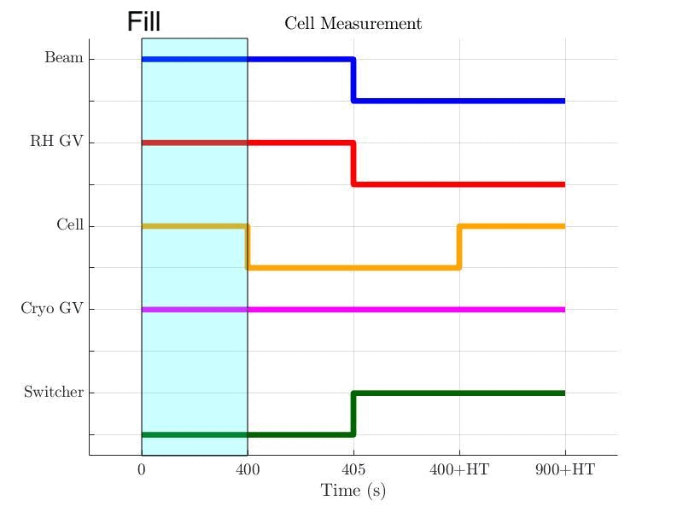
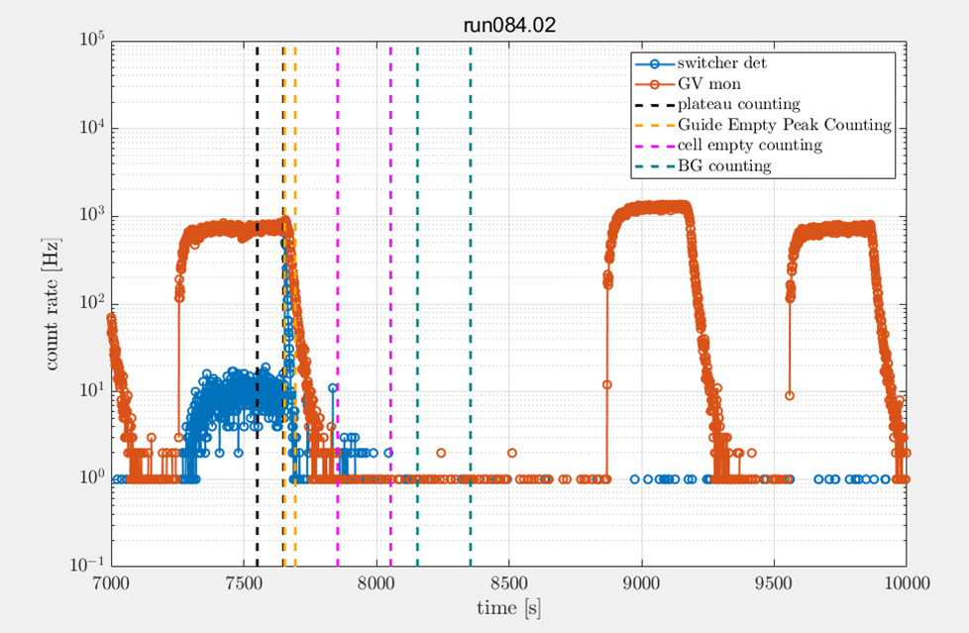
Overview of Measurement
200 sec hold
Experiment 2/2

Slide 7
History of measurements we’ve made
Why so many cells?
Why did we measure ncsu4 so long?
Skip. Will take too much time.
Can say made different cells (LANL 1 & 2, NCSU 1,2,3,4,) to continually improve process and to test reproducibility.
NCSU4 was measured for so long because at different beam locations so UCN spectrum/normalization different. Couldn’t control systematics from different loaded UCN spectrum
Experiment 3/3

Slide 8
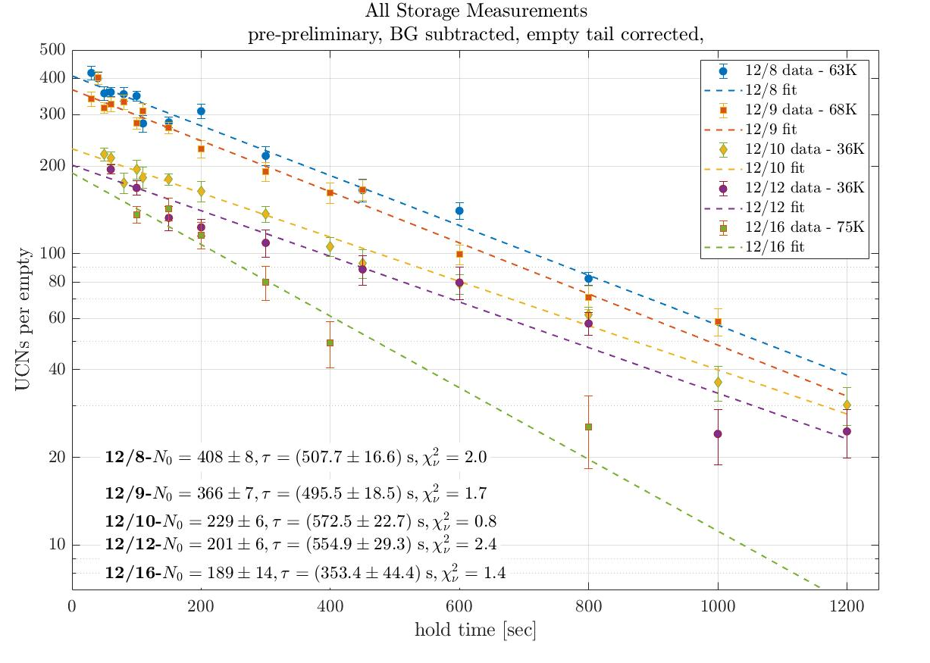
2021 Results
Single exponential
𝜏_{st} ~ 508±17 s @ 65 K & 570±22 s @ 36 K
Single-exp storage could imply EITHER:
A.) No strongly energy dependent loss (ie: no small weak patch of fermi potential ~90 neV)
B) A very strong energy-dependent loss time such high-energy UCNs loss very quickly before our shortest holding time of 15 s
C.) No higher energy neutrons were loaded in the first place
Did not see neutrons when we used Al or Zr foil as high pass filter
Stopped pumping & used exchange gas
𝜏 ~ 353±44 s
Results 1/4
Notes:
570 s storage time implies ~1600 sec UCN wall loss time
but due to small hole on cell, UCNs to have to on average pass through foil many times before making inside the cell)
record fermi potentials (al = 54 neV, Zr = ?)

Slide 9
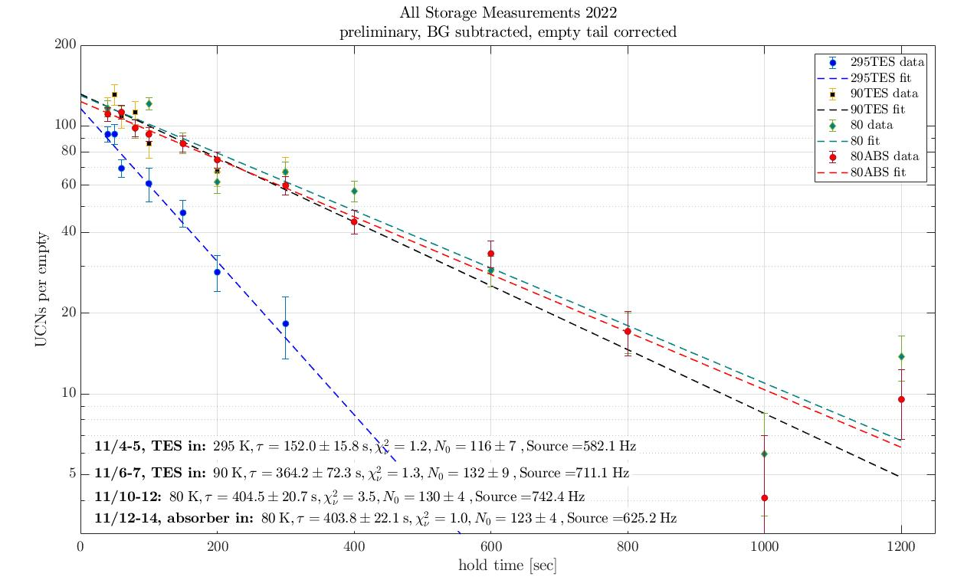
2022 Results
Repeated measurements in 2022 only shows the short 𝜏_{st}
405±21 s @ 80 K
Cells has been subjected to ~ 5 LHe cycles and many vents and pumps. Did we permanently degrade the cell? (Contamination (see later) or otherwise)
Additionally, we added an absorber to act as a low-pass filter (~ 100 neV) but saw no difference in 𝜏_{st}
404±22 s @ 80 K
This implies that we are not observing high-energy UCN in our storage lifetime measurements (cell, guide, combination?)
Results 2/4

Slide 10
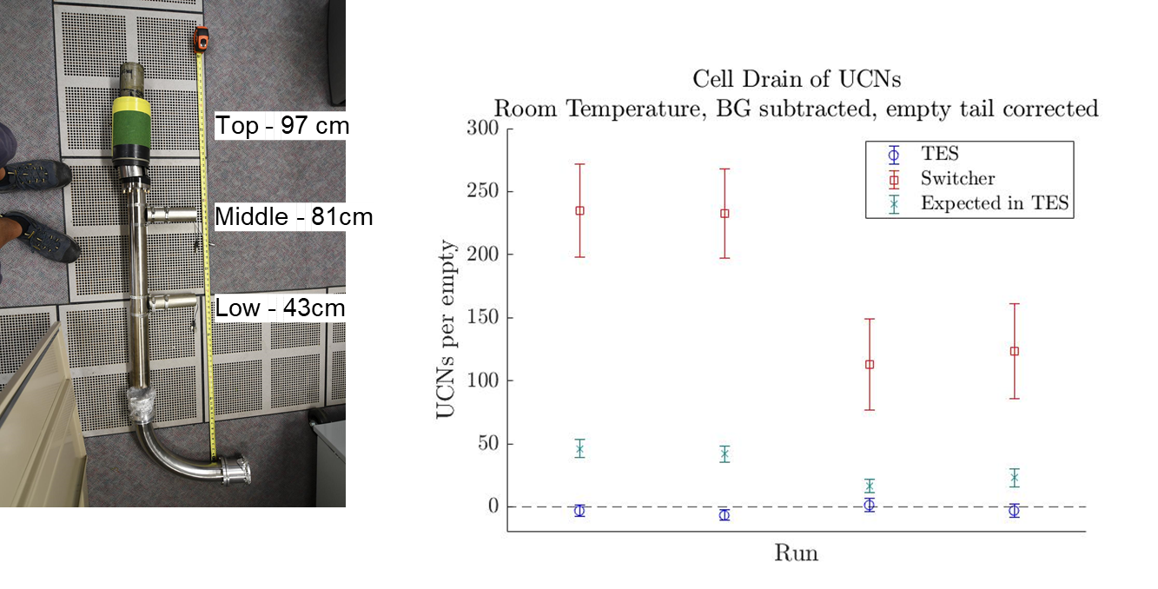
2022 - TES
Energy spectrometer that we placed in various places along the beamline to get a handle on the energy spectrum
Didn’t see any change in spectrum between the RH and after the switcher at RT
During the guide drain, we see ~ 1 count in top TES detector (~100 neV) for every 5 in the switcher (~0 neV)
However, after holding neutrons in the cell for the shortest possible hold time - 15 sec - we do not see *any* counts in the top TES detector despite seeing 100+ in the switcher detector.
Results 3/4
Notes:
However, we see very short UCN storage time in guides leading up to cell (see next). Is this loss strongly E-dependent?

Slide 11
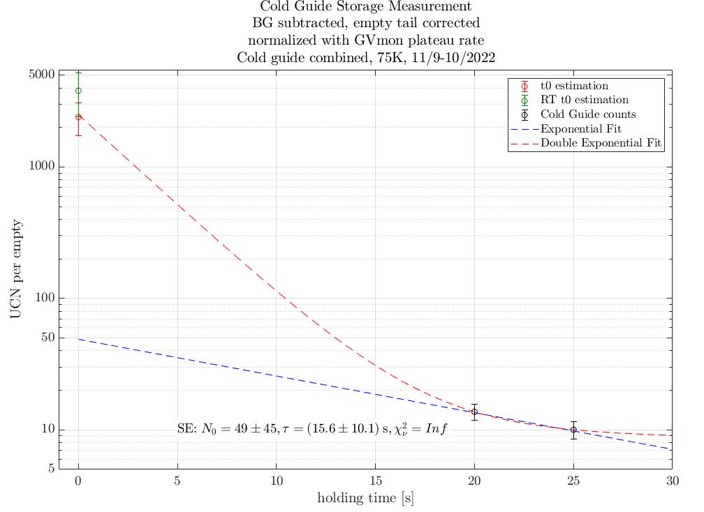
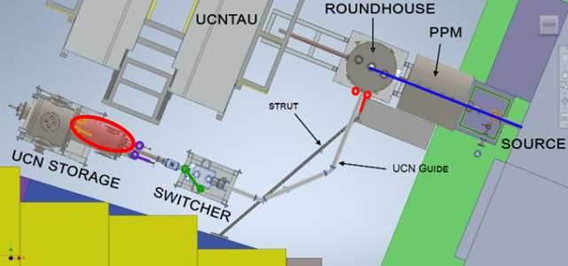
2022 - Guide Storage
We used a gate valve to hold the neutrons in the section of guide immediately adjacent to the measurement cell
We hold very few neutrons in this section of guide, even at short holding times
𝜏 ~ 5 s
Results 4/4

Slide 12
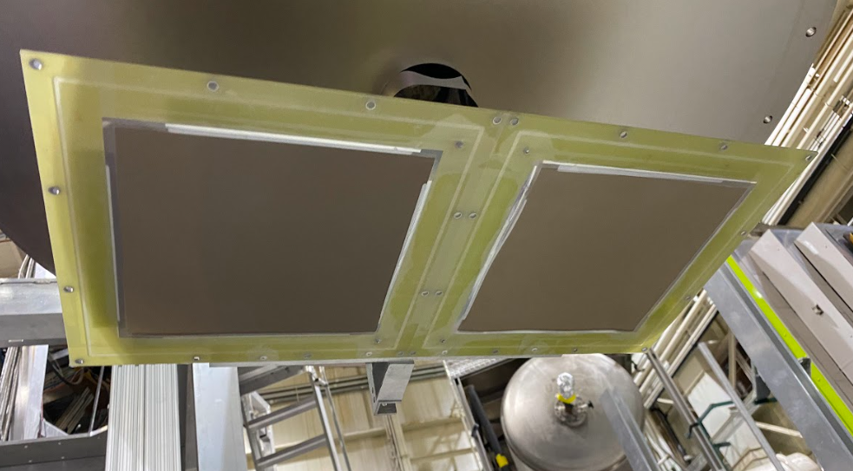
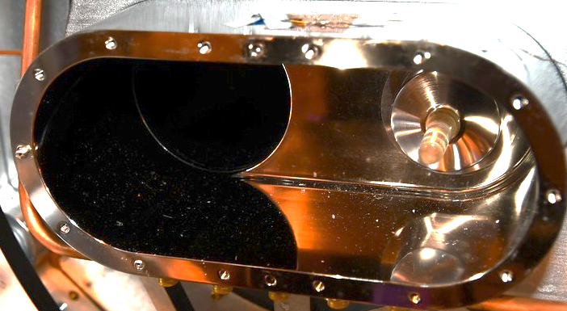
Problems with current setup
We did not have a reliable way to get a handle on the UCN energy spectrum in the guides versus in the cell.
Existing LANL RH has movable Boron absorber (used in 2022), but this takes a lot of effort, cooperation from other experiments, requires venting to change positions, etc.
When cleaning the guide this year, we found a fair amount of debris in the guides
If ~0.02 cm² area of dust got into cell, could explain degradation from storage time 560 s -> 405 s
Improvements 1/5

Slide 13
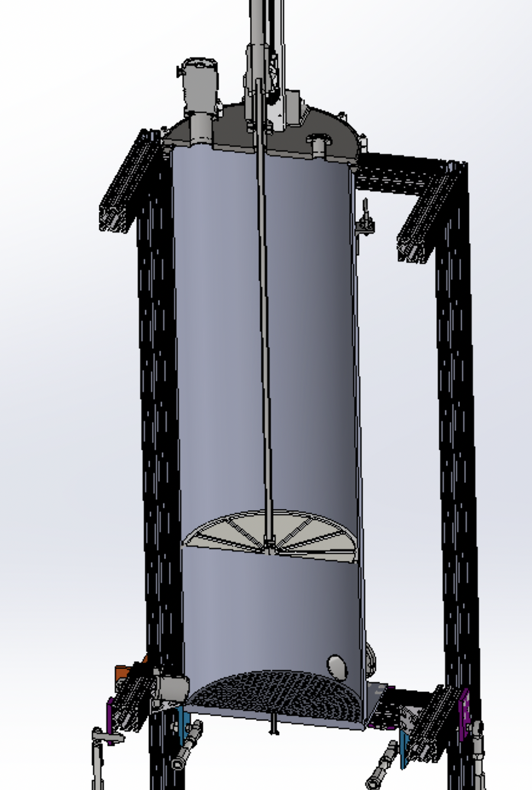
Improvements to our apparatus
Magnetically-coupled motion feedthrough. Got catalogue from LANL. Ordered from Nor-Cal
New Roundhouse as a low pass spectrum filter
Better control of our energy spectrum without disruption of others Change UCN spectrum without venting vacuum system Change measurement procedure of UCN spectrum in roundhouse, in guides, and in cell
Deduce 𝜏_{cell}(E)
New cell - MSU1 (open cell bead coating)
Replacing the old switcher (a known source of loss) with a tee and gate valves leading to a drop detector
Bare Stainless steel surfaces (~185 neV)
Ti foil absorber
20” SS tube (cleaning now)
Improvements 2/5

Slide 14
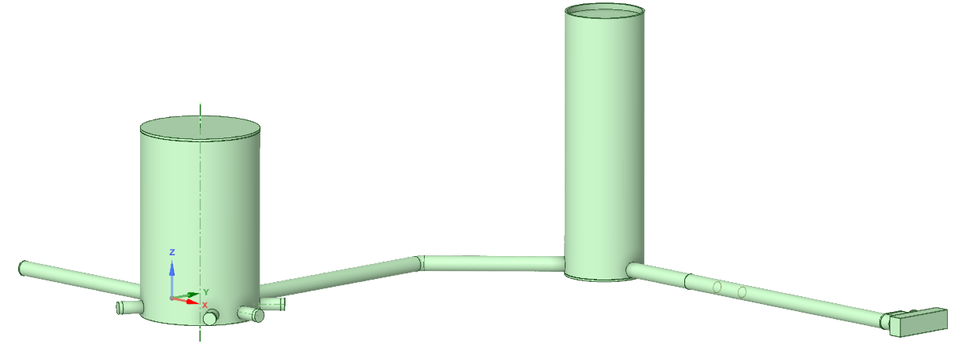
Simulations with PENTrack
After benchmarking our simulations to experimental data, we simulated the new geometry
Current Geometry at LANL
(Geometry 1)
Soon to be Geometry
(Geometry 3*)
TEE
NEW RH
ROUNDHOUSE
NEW RH with movable top absorber
ROUNDHOUSE
UCN GUIDE
SWITCHER
Or
TEE
SOURCE
SOURCE
UCN GUIDE
UCN STORAGE
TEE
UCN STORAGE
Improvements 3/5

Slide 15
Simulation Results
Adding our new roundhouse decreases the number of neutrons we can obtain in our measurement cell
Green arrow represents a direct comparison - showing ~25% loss
But, by replacing the lossy switcher with a tee, we expect to recuperate some loss
The red arrow represents this - showing a ~9% decrease
The decrease is well within our acceptable tolerances for the functionality gain of the new RH
4423 (72)
3811 (59)
3304 (55)
Geometry
1 - Current RH
3 - Current RH to New RH
Improvements 4/5

Slide 16
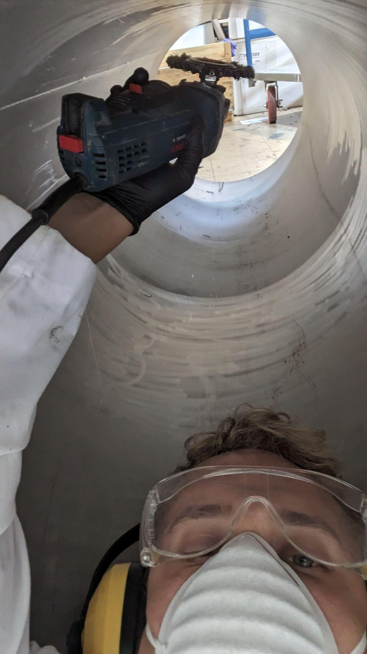
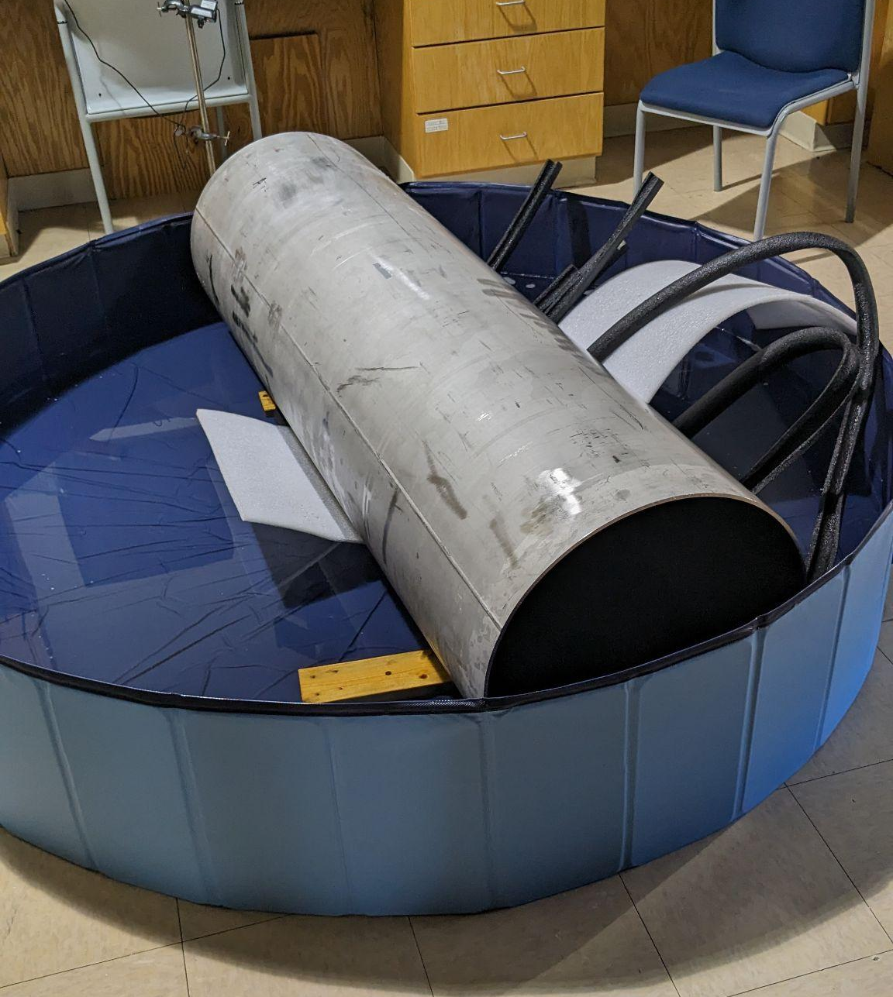
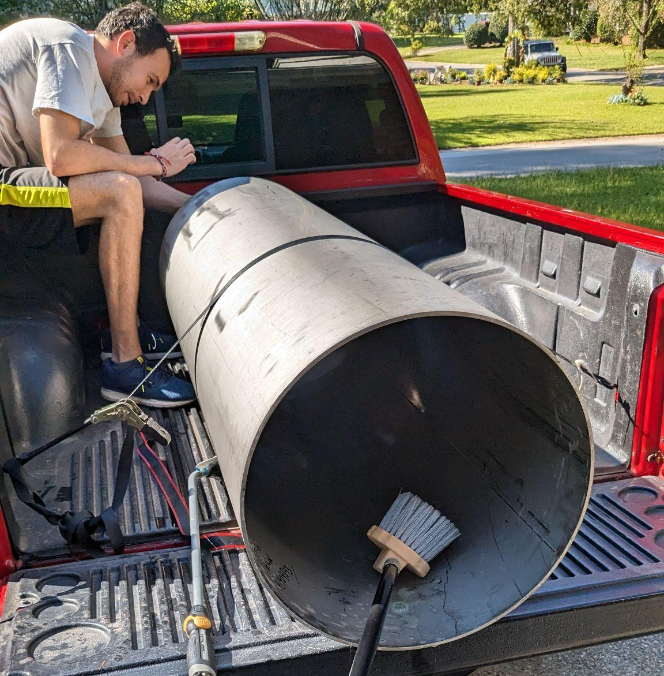
New RH Progress
Improvements 5/5

Slide 17
Conclusions
We have a team in place with several years of experience to complete the UCN measurement cell storage experiments for nEDM@SNS
Initial holding time results from NCSU4 were promising, but we could not definitively prove that we were holding high-energy UCNs
𝜏_{st} ~ 570±22 s @ 36 K -> 𝜏_{cell} ~ 1600 sec in 2021
2022 results indicated large, energy-dependent UCN loss, but uncertain culprit
We are in the process of building and assembling a new roundhouse that will allow us much greater control over the energy spectrum, more opportunities to benchmark neutron counts/holds along the beam, and reduce loss
Conclusion

Slide 18
Acknowledgements
Experimental Collaboration: Kent Leung, Wolfgang Schreyer, Adam Dipert (post-doc), Martin Cooper, Ekaterina Korobkina, Bob Golub, Ito Takeyasu, Steven Clayton, Mark Makela, Chris O’Shaughnessy, Chris Morris, Matthew Morano (grad student), Scott Currie, Wade Uhrich, Paul Huffman
Acknowledgements

Slide 19
Backup Slides
Backup

Slide 20
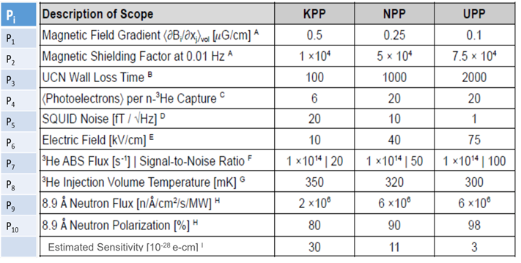
Parameter Goals for nEDM@SNS

Slide 21
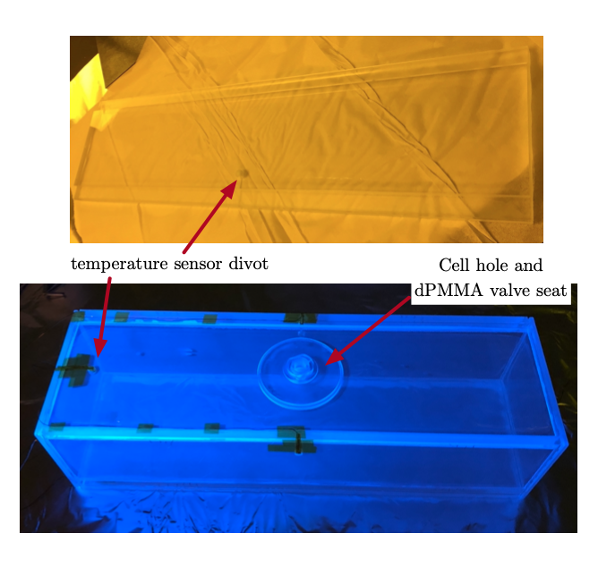
UCN Storage – Cell Requirements
Highly non-magnetic
Stable in high- electric fields and across pressure gradients
Non-electrically conductive (pPMMA) walls held together by deuterated “cement”
Do not spin depolarize UCNs and co-magnetometers (dPS coating)
Coating that wavelength shifts light (dTPB coating)
Cell Hole and dPMMA valve seat
Temp. Sensor Divot
Credit: Kent Leung
Backup

Slide 22
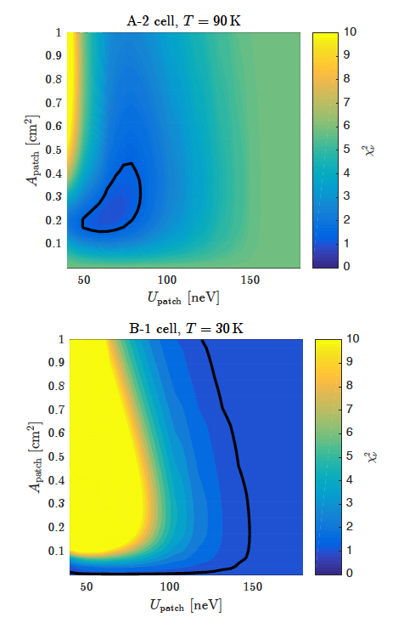
Potential weak patch analysis
If the neutrons encounter some material with lower optical potential, higher-energy UCN would be lost at a rate dependent on the effective area and potential of the patch
Most likely location for patch would be at seams/corners or at cell valve, but would be difficult to isolate in fully formed cell
Can constrain the parameters of the patch based on energy dependence of the UCN storage time
Weak patch in A2 vs. no patch in B1

Slide 23
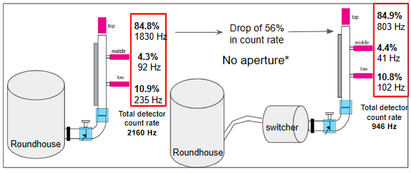
No Change in UCN Spectrum from Room Temperature Guide
Relative percentages unchanged
Backup

Slide 24
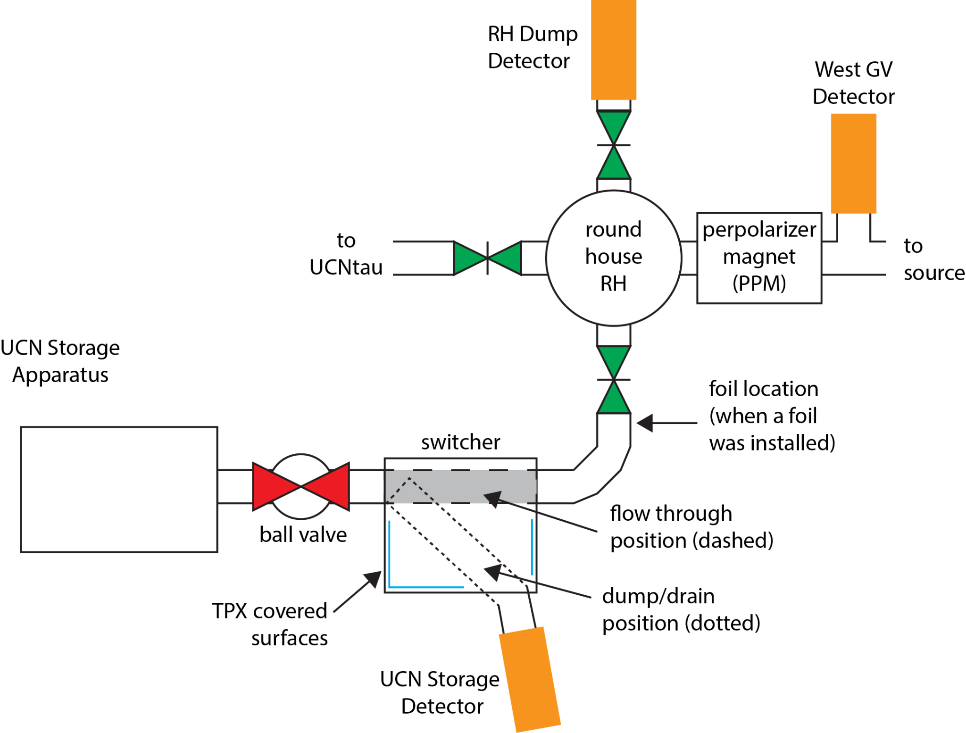
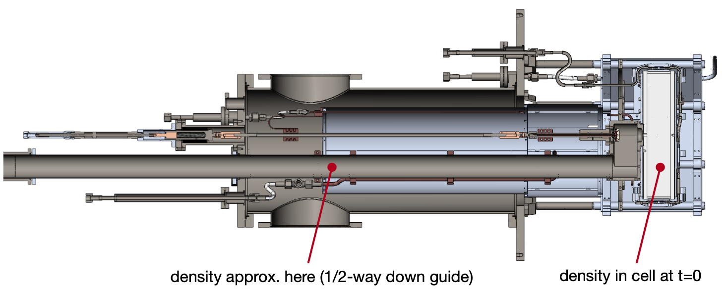
Setup Schematics
300K: 0.27 UCN/cm³ & 0.039 UCN/cm³ 80K: 0.17 UCN/cm³ & 0.043 UCN/cm³
Backup

Slide 25
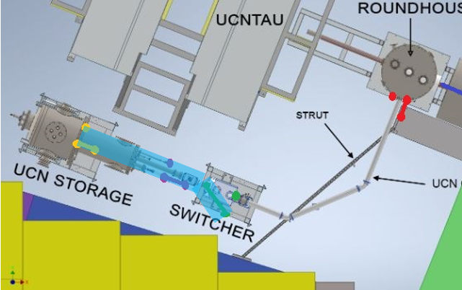
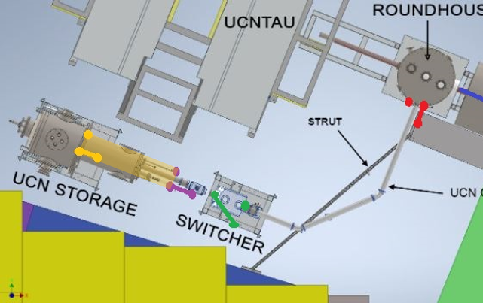
How do we get t=0 point?
Guide drain during cell storage
-
N₀ of Warm Guide measurement
=
Neutrons from “apparatus” guide” at t = 0
N0 = 3710 ± 119
N0 = 1027 ± 182
“Apparatus guide” also sometimes referred to as “cold guide” but temp gradient across this guide
Backup

Slide 26
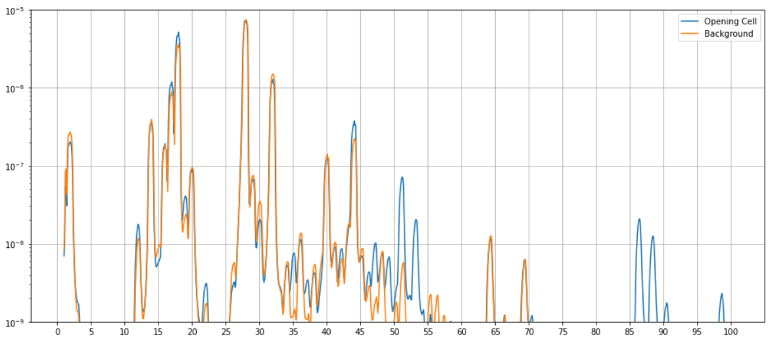
What’s in the cell?
Background vs. when we opened the cell (which was at room temperature)
The relative pressure differences can not be taken at face value given that most pumps were still open and connected to the system. As such, large pressure gradients existed during measurement.
The main masses that changed correspond to vaporized deuterated dichloromethane (CD2Cl2)
51, 53, 86, and 88
Additionally a ~5e-7 increase in CO₂ (44)

Slide 27
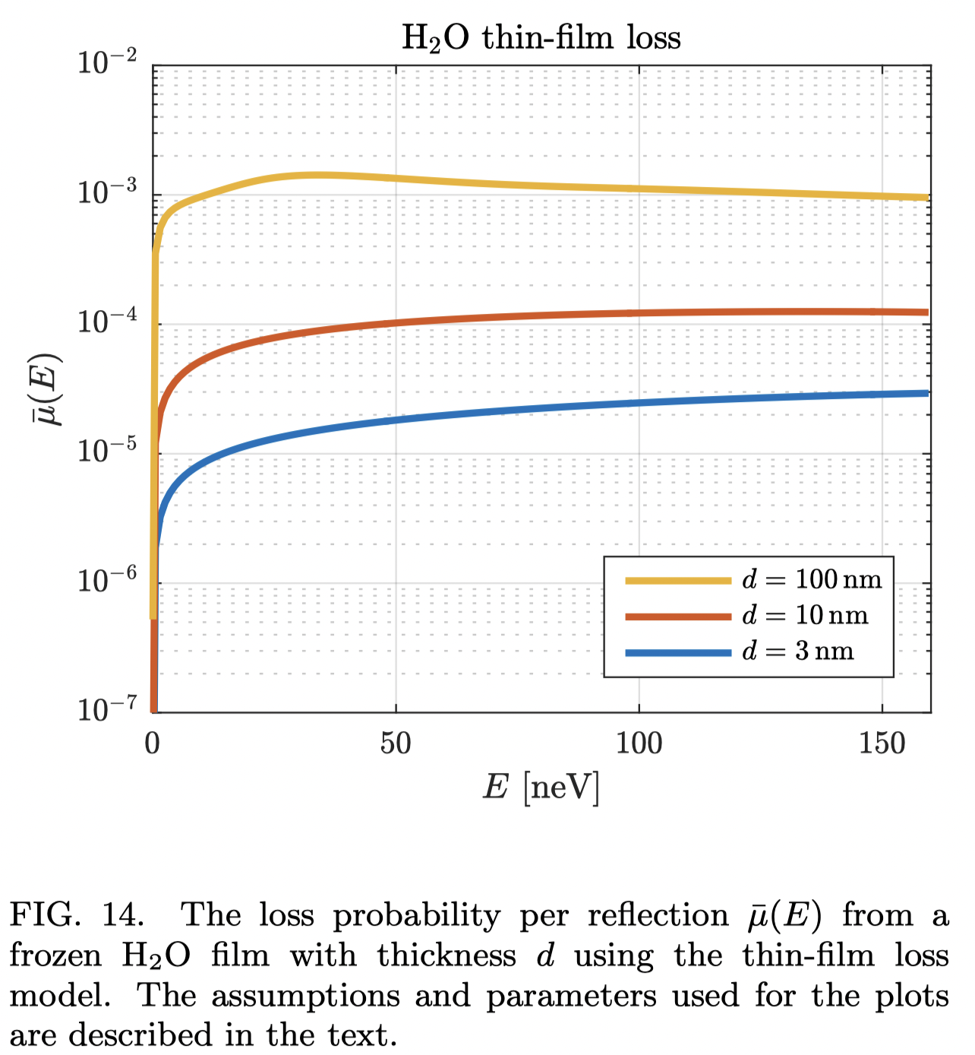
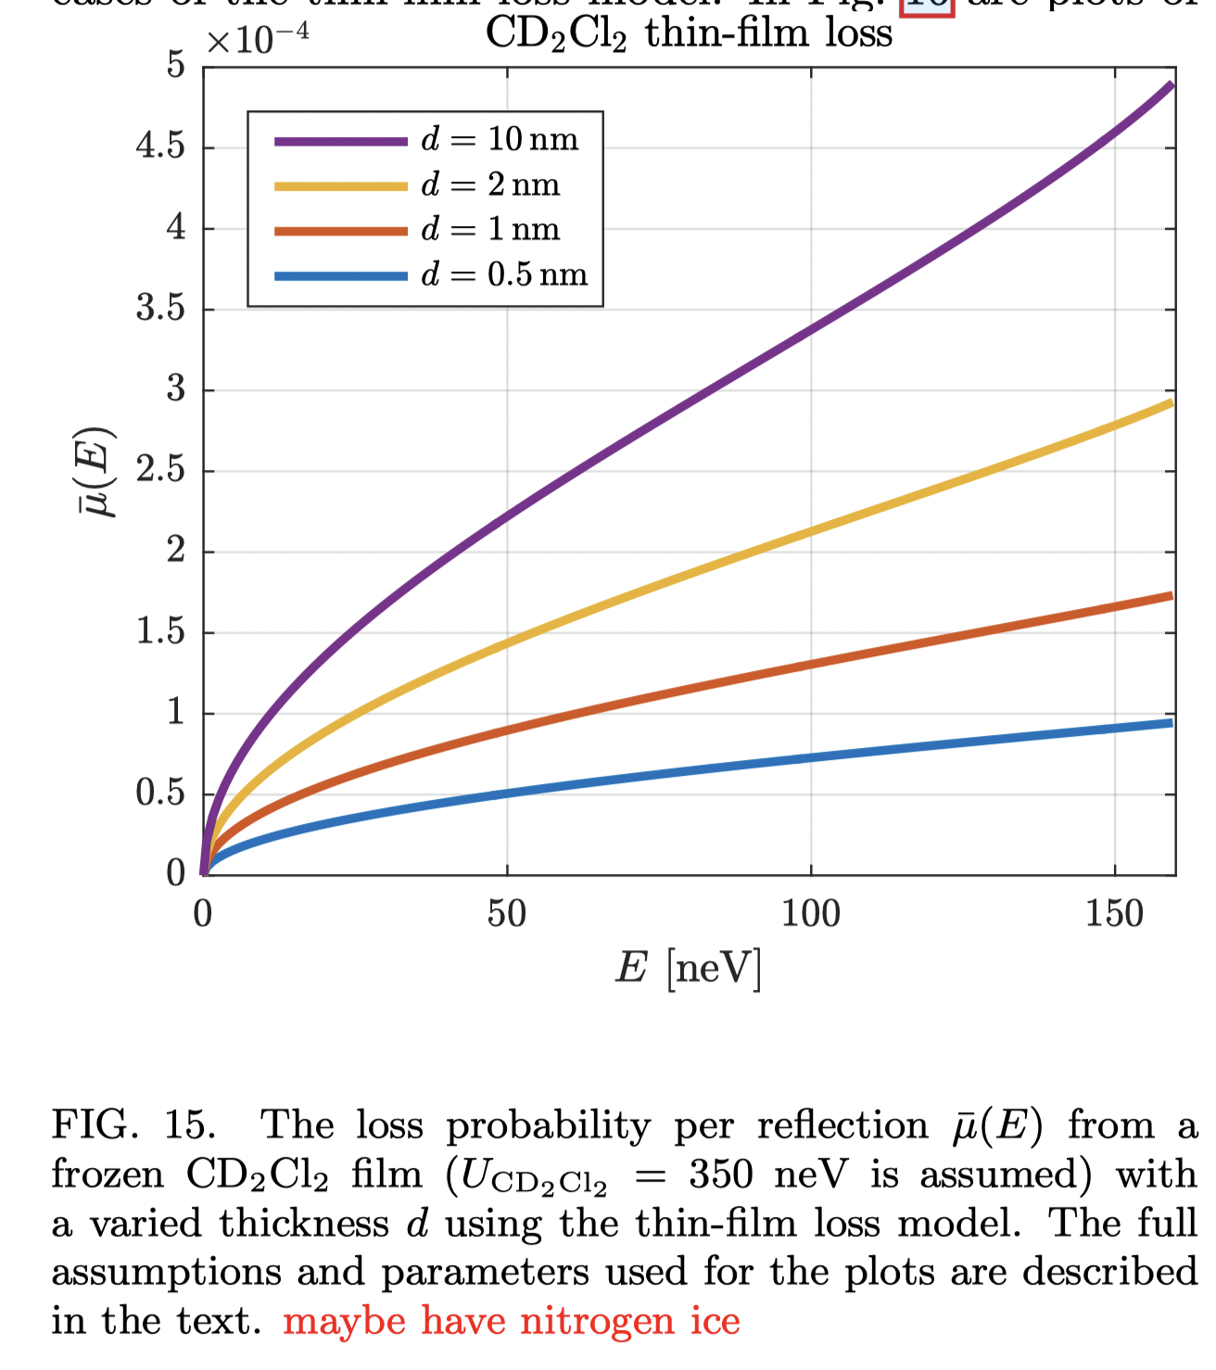
Is CD2Cl2 the issue? - likely not
CD2Cl2 has a large Fermi potential - 350 neV (so it could not be the weak patch)
We know we observed a wall loss of ~2e-5 per bounce based on our ~400s lifetime, which, if we, assumed was entirely from frozen H₂O, that loss correlates to a layer of ice ~ 5 nm thick.
And, comparing RGA measurements from previous years, we have anywhere from ~ 0-3 orders of magnitude less CD2Cl2 than water.
Using that - a broad range thickness estimate for CD2Cl2 is 5 - 0.005 nm.
Even with the high end estimate of 5 nm, it would not be enough to explain excess loss

